Slide 1
Federal Student Loan Forgiveness 2022

Slide 2
Ten Things about Student Loan Forgiveness
Is student loan a bad idea?
Should wealthy students borrow student loans?
Can I double dip?
Can my child borrow this year and ask for forgiveness?
Should I, a parent, borrow a PLUS loan and ask for forgiveness?
Should I, a grandparent, borrow a private loan and how to let it go?
What is student loan interest tax deduction $2,500?
Will I pay state level income tax for debt forgiven?
529 and student loan
What are my action items?

Slide 3
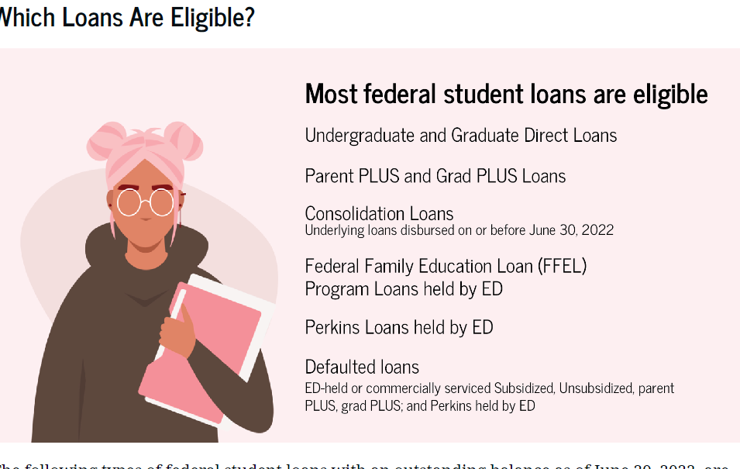
The “F” word

Slide 4
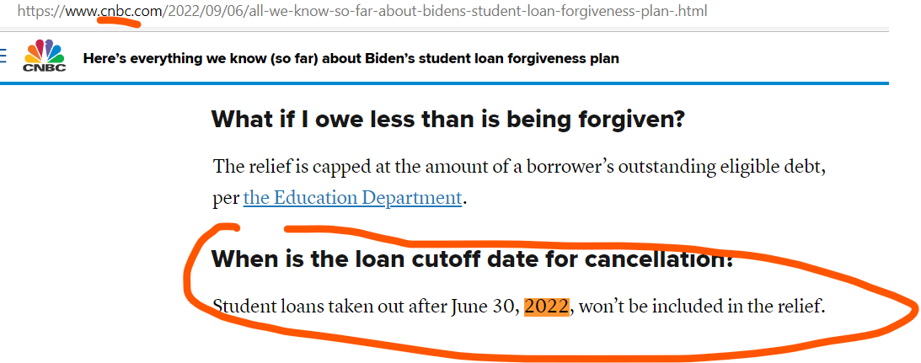
Can I borrow new loan and get forgiven?

Slide 5
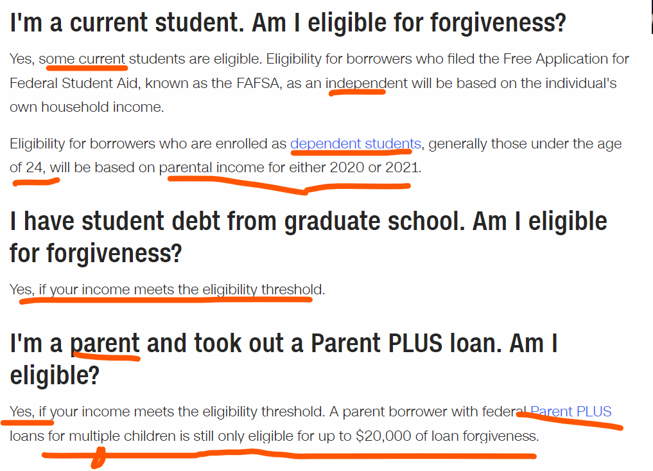
Current students and their parents?

Slide 6
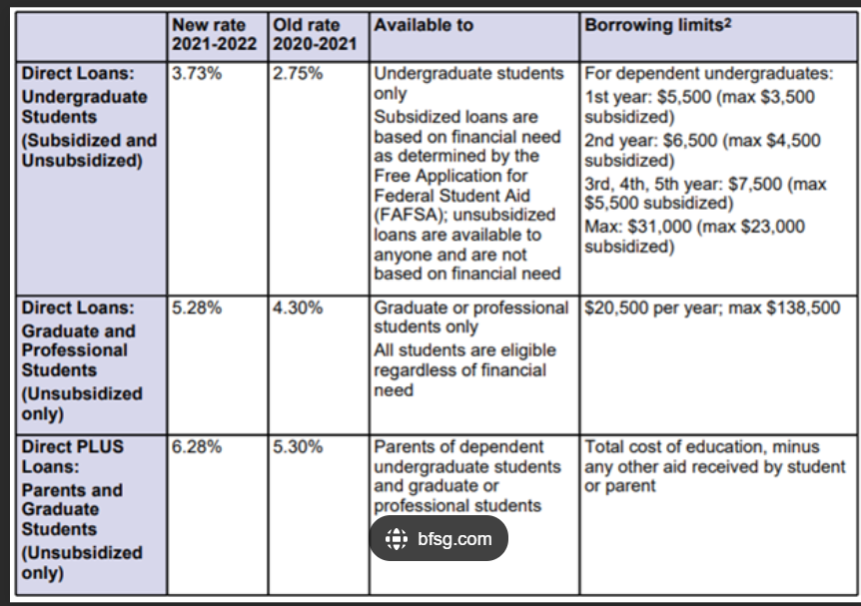
Federal Student Loan Rate

Slide 7
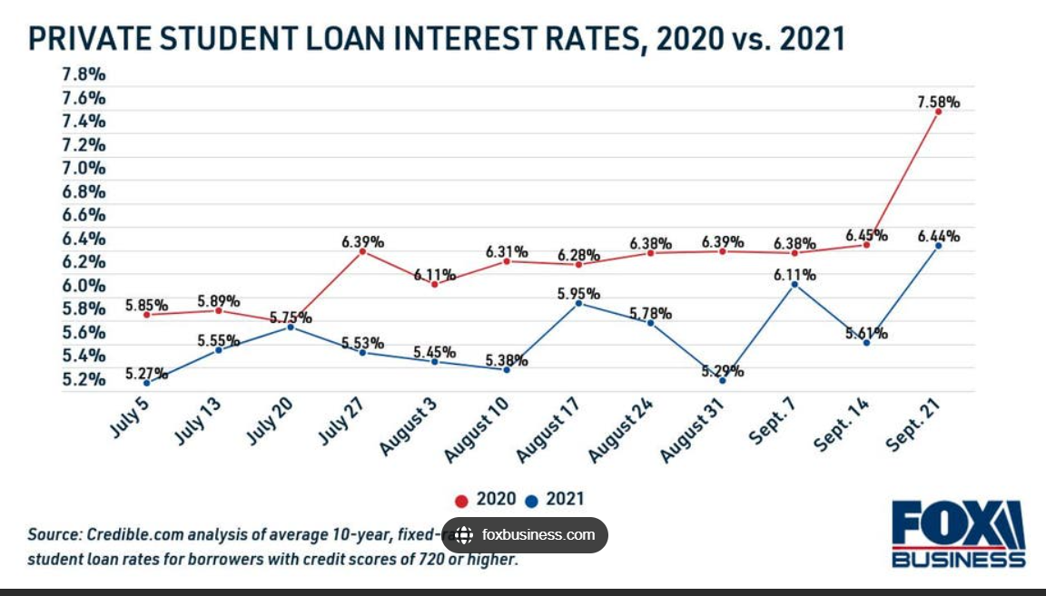
Private Student Loan Rate

Slide 8
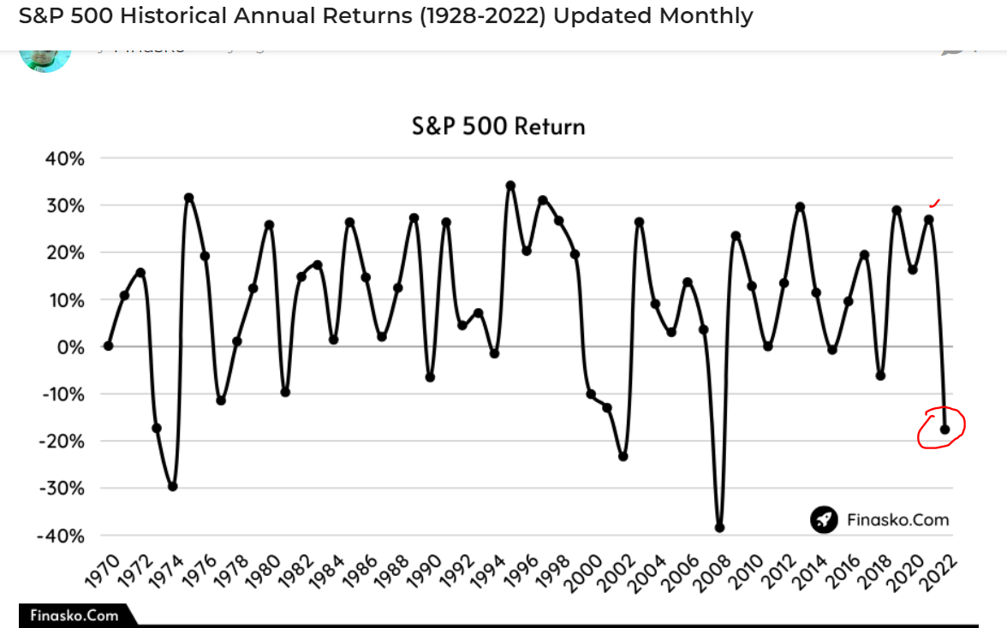
Student Loan vs. S&P 500

Slide 9
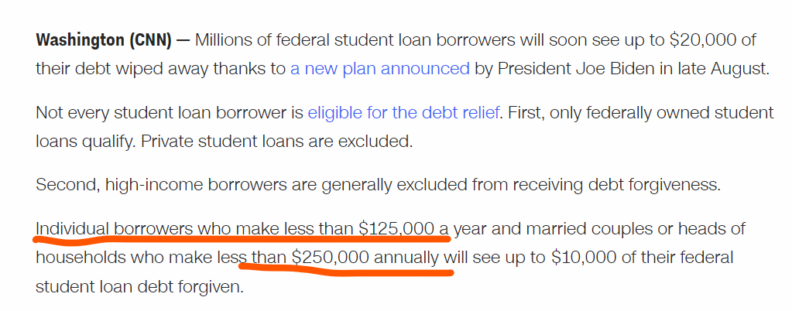
How to bring AGI below $125,000?

Slide 10
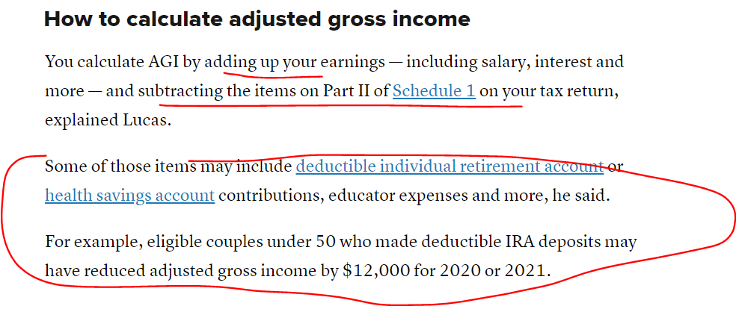
How to bring AGI below $250,000?

Slide 11
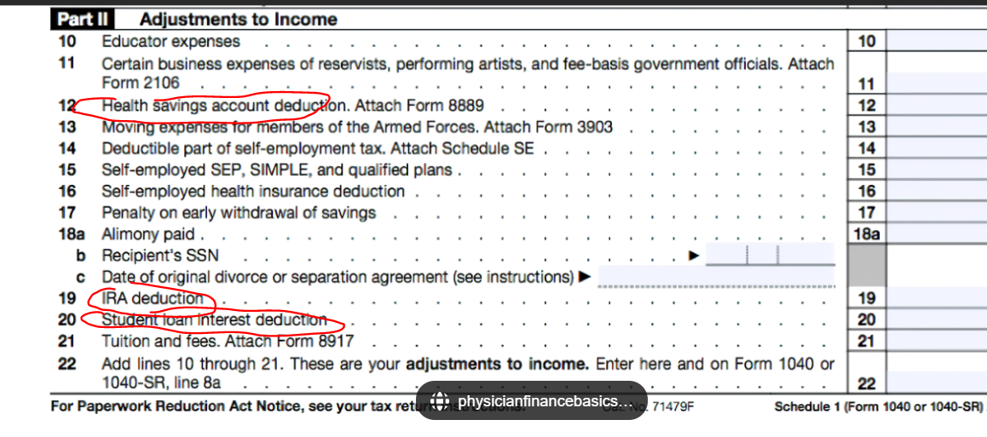
How to bring AGI below $250,000?

Slide 12
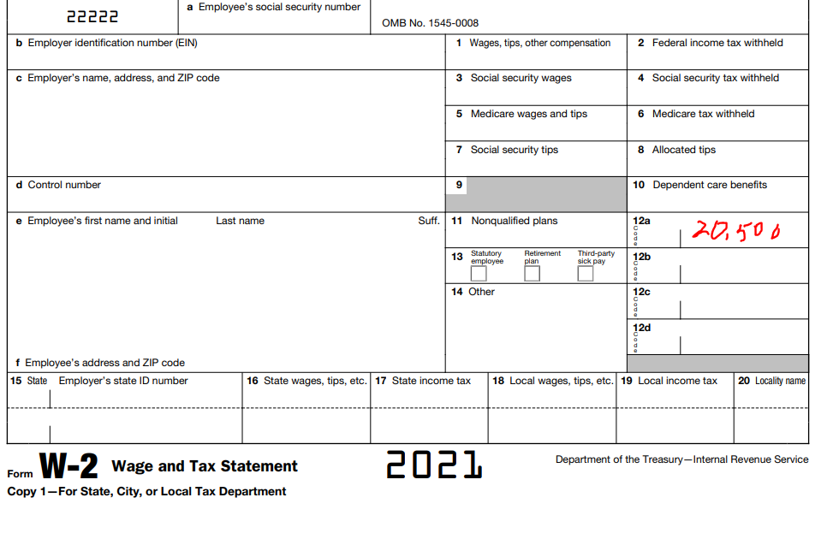
How to bring AGI below $250,000?

Slide 13
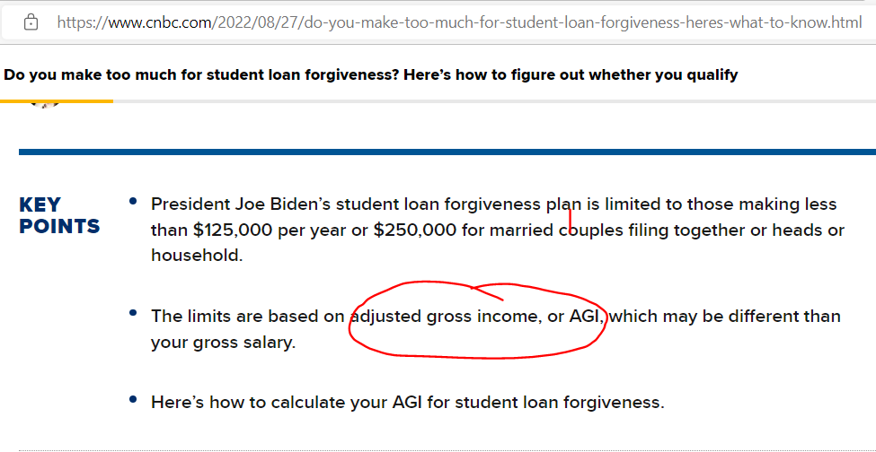
Do you make too much for student loan forgiveness? Here’s how to figure out whether you qualify

Slide 14
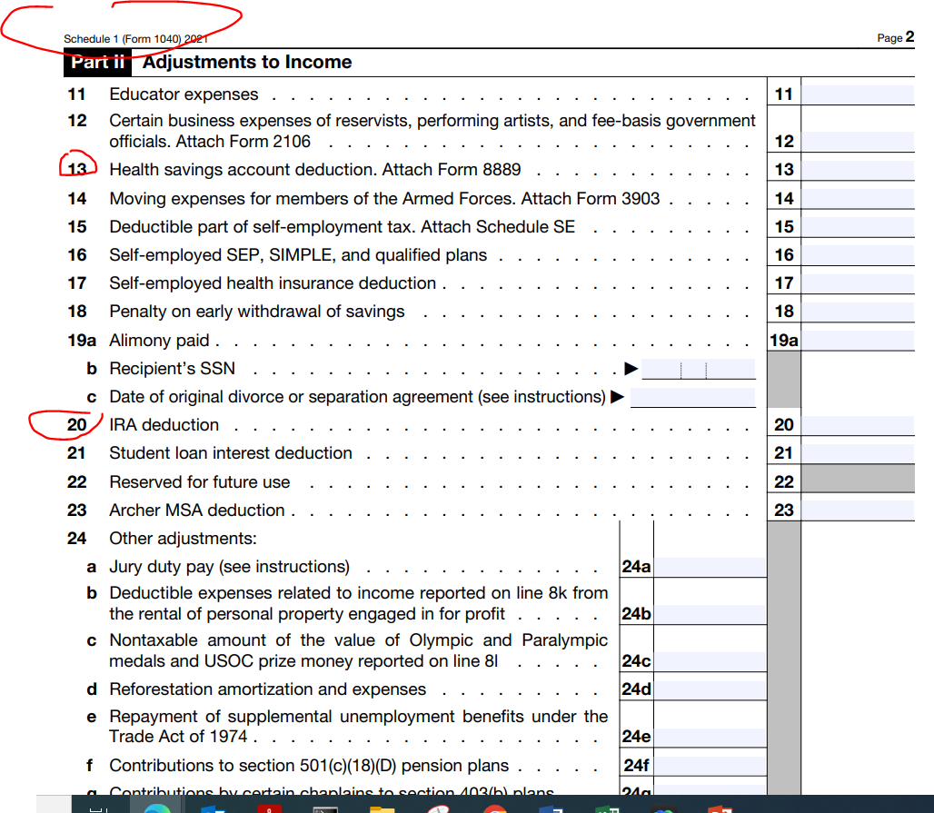
d

Slide 15
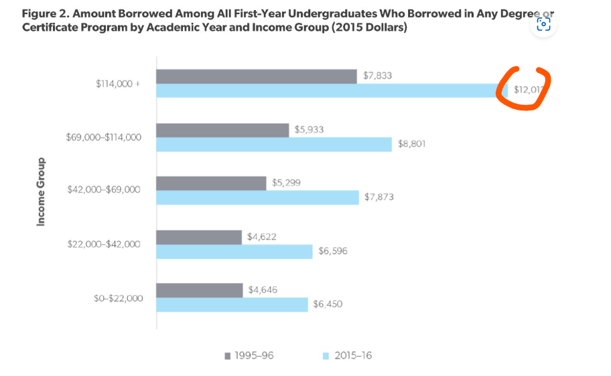
Why wealthy people borrow student loan?

Slide 16
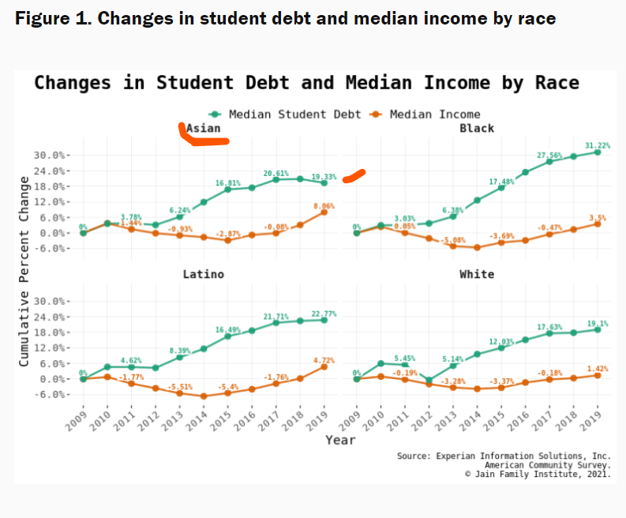
Why Asian families don’t like to borrow student loan?

Slide 17
Da-Sa-Bi

Slide 18
PLUS Loan

Slide 19
PLUS Loan

Slide 20
Grandparents Student Loan

Slide 21
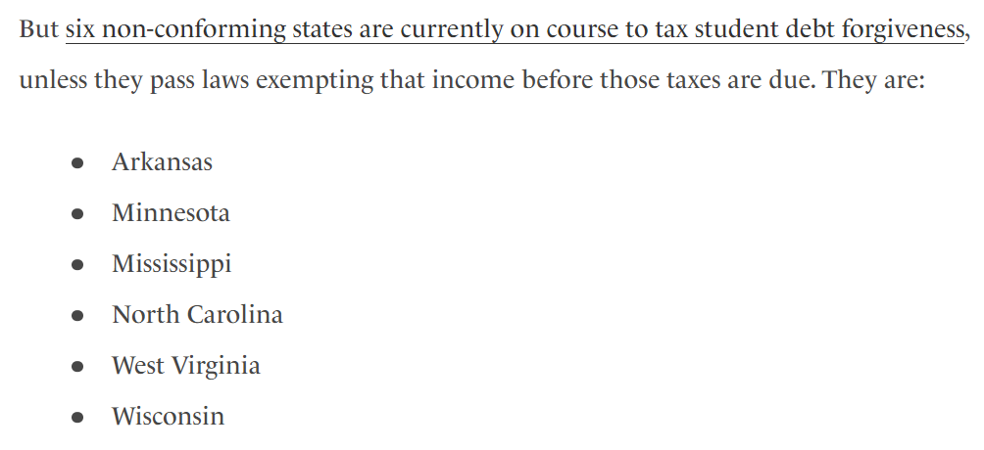
State Income Impact

Slide 22
529 and student loan
Parent 529 (set up at junior year in college)
Grandparent 529: as early as possible
Older sibling 529: right after college

Slide 23
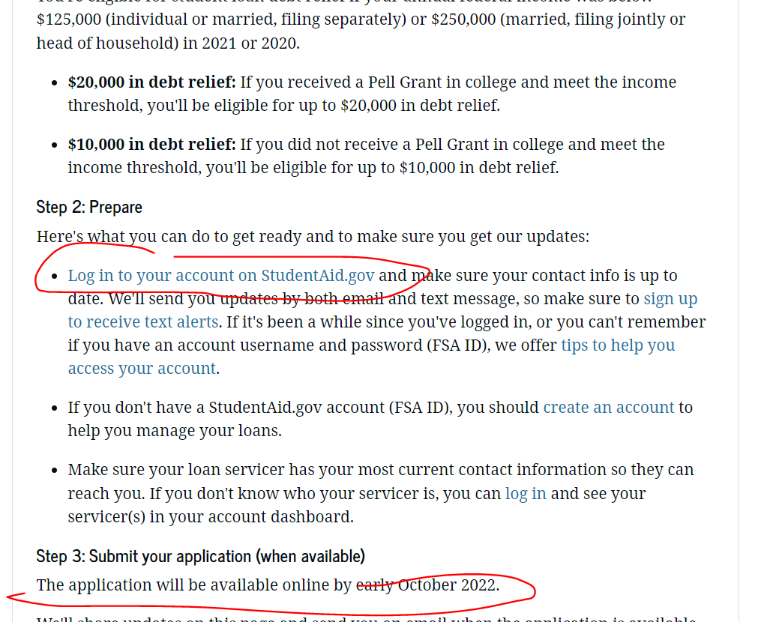
Action Item: FAFSA is a must

Slide 24
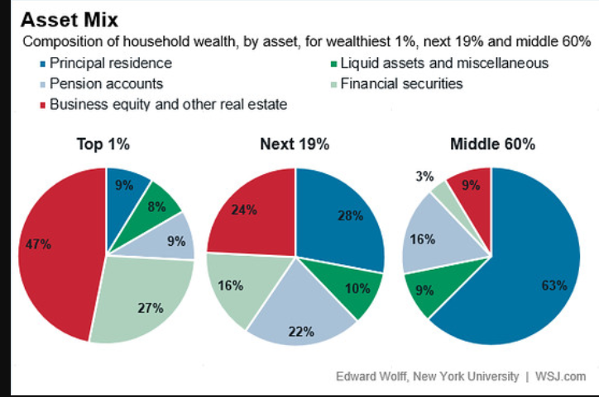
Action Item: Look at asset mix of your family

Slide 25
Tax consult: Coach Mike Nie, CPA, CFA, CFP, IRS Enrolled Agent 703-606-0270 help@smart1040.us Eight week program from 9/14/2022

Slide 26
