Slide 1
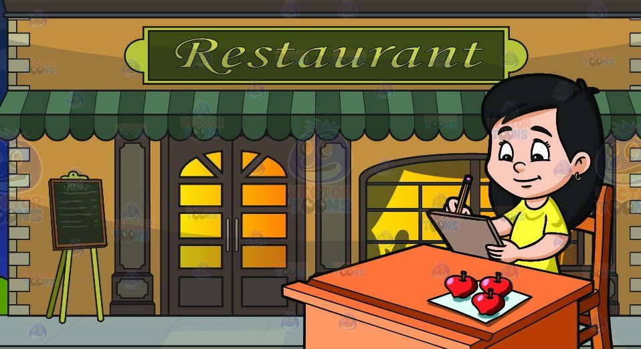
Restaurant Reservation 预定餐厅位子
Good evening. How may I help you? 晚安，您需要什么呢？
Good evening. I’d like to make a dinner reservation for this evening. 晚安，我想要订位, 是今天的晚餐。
Just a moment please and I’ll check our reservations book. Okay, how many people are there in your party? 请稍等一下，我查一下我们的预约薄。没问题，请问你们有几位？
There’ll be six, four adults and two children. 六位，四个大人和两个小孩。
What time would you like the reservation for? 请问你的订位要从几点开始呢？
6:30, please. 六点半。
Alright, and what is your name? 好的，请问您的姓名？
It’s Shelly. 我是雪莉。
OK, Shelly. So, that’s a party reservation for six, tonight at 6:30. 好的，雪莉。为您预订了6位，今天晚上6点半。
Yes, that’s right. Thank you very much. 是的，非常感谢你。

Slide 2
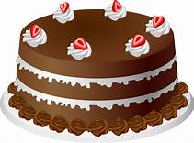
Buy a Cake 买蛋糕
Jason, where are you going? 杰森，你去哪儿？
I want to buy a cake. 我想买个蛋糕。
Wait a minute and I’ll go with you. I want to buy some oranges. 请稍等一下，我和你一起去。我想买些橘子。
Should we check out the bakery section first? 我们先去糕点部看看？
OK. What flavor do you want? Vanilla or chocolate? 好的。你喜欢什么口味？香草的还是巧克力的？
Chocolate. I will take this chocolate cake. 巧克力口味的。我就要这个巧克力蛋糕吧。
It looks delicious. I will get some oranges. 看上去真好吃。我去买些橘子。
Do you want to buy anything else? 你还要需要买别的吗？
No. Let’s go over to the check-out counter. 不买了。我们去收款台吧。

