Slide 1
English Dialogues:
A: Can I help you? You seem lost.
B: Yeah, actually I am.
A: Where are you trying to go?
B: I’m trying to find the post office.

Slide 2
Can you tell me how to get to the post office?
… the museum
…the zoo
...the school
…the metro station
…the theater
I’m sorry. I don’t know
Sure. It’s not far from here.
Walk straight ahead.
It’s about two or three blocks.
It’s the first traffic light you come to then turn right.
You can’t miss it.

Slide 3
A: Do you think it will rain today?
B: Yeah, maybe. It’s hard to tell.
A: I hope not. I’m going to the beach this afternoon.
B: Maybe you should check the weather forecast first.
A: Good idea. I think I will.
B: Well, I hope you have a good afternoon.
A: You too, Frank.

Slide 4
A: Oh, hey. Did you have a good time hiking today?
B: Yes, although it was a bit hot.
A: That’s why I stayed inside.
B: What did you do?
A: I read a book.

Slide 5
A: Hello, how are you doing?
B: Not bad. Work is going well.
A: Oh, is it? That’s good to hear.
B: What about you?
A: I’m doing okay, although my car is in the shop.
B: Oh, really? That’s too bad.

Slide 6
A: What’s up, Andrew?
B: Not much. Not much at all.
A: Are you hungry?
B: A little bit. Do you want to eat?
A: Yes. Let’s go and find something to eat.
B: That sounds good to me.

Slide 7
A: Anyone up for a drink?
B: Sure, I could use a drink.
A: Me too. I really want a beer.
B: Where do you want to go?
A: I was thinking about going to that new place.
B: The one next to post office?
A: Yeah, I hear it’s pretty cheap.
B: Well, what are you waiting for? Let’s go.
A: Sounds good. After you.

Slide 8
A: Hi, I’m Marvin.
B: Marvin? My name is Julia.
A: I’m here to play basketball.
B: Good. We need more people to play.
A: I’m not very good.
B: That doesn’t matter. We’re just here for fun.

Slide 9
A: Mom, it looks like my flight is boarding.
B: Yes, I guess it is.
A: I should go now. I’ll call you when I land.
B: Yes, please do that. I want to know you’re safe.
A: Don’t worry so much. I have to go. I love you.
B: I love you, too. Bye dear.

Slide 10
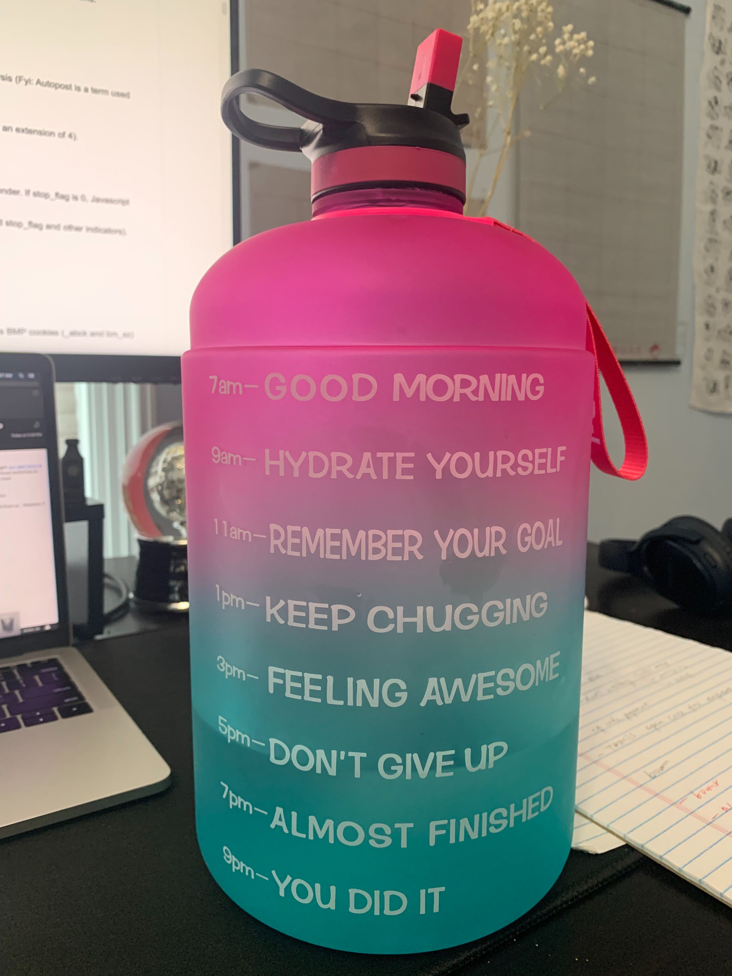

A: It’s so hot these days.
B: Yes, make sure you drink plenty water.
A: Agree. But sometimes I forget to drink water.
B: oh, do you know there is a bottle that can remind you to drink water?
A: Really? Nice. Where can I get it?
B: You can get it from Amazon.

Slide 11
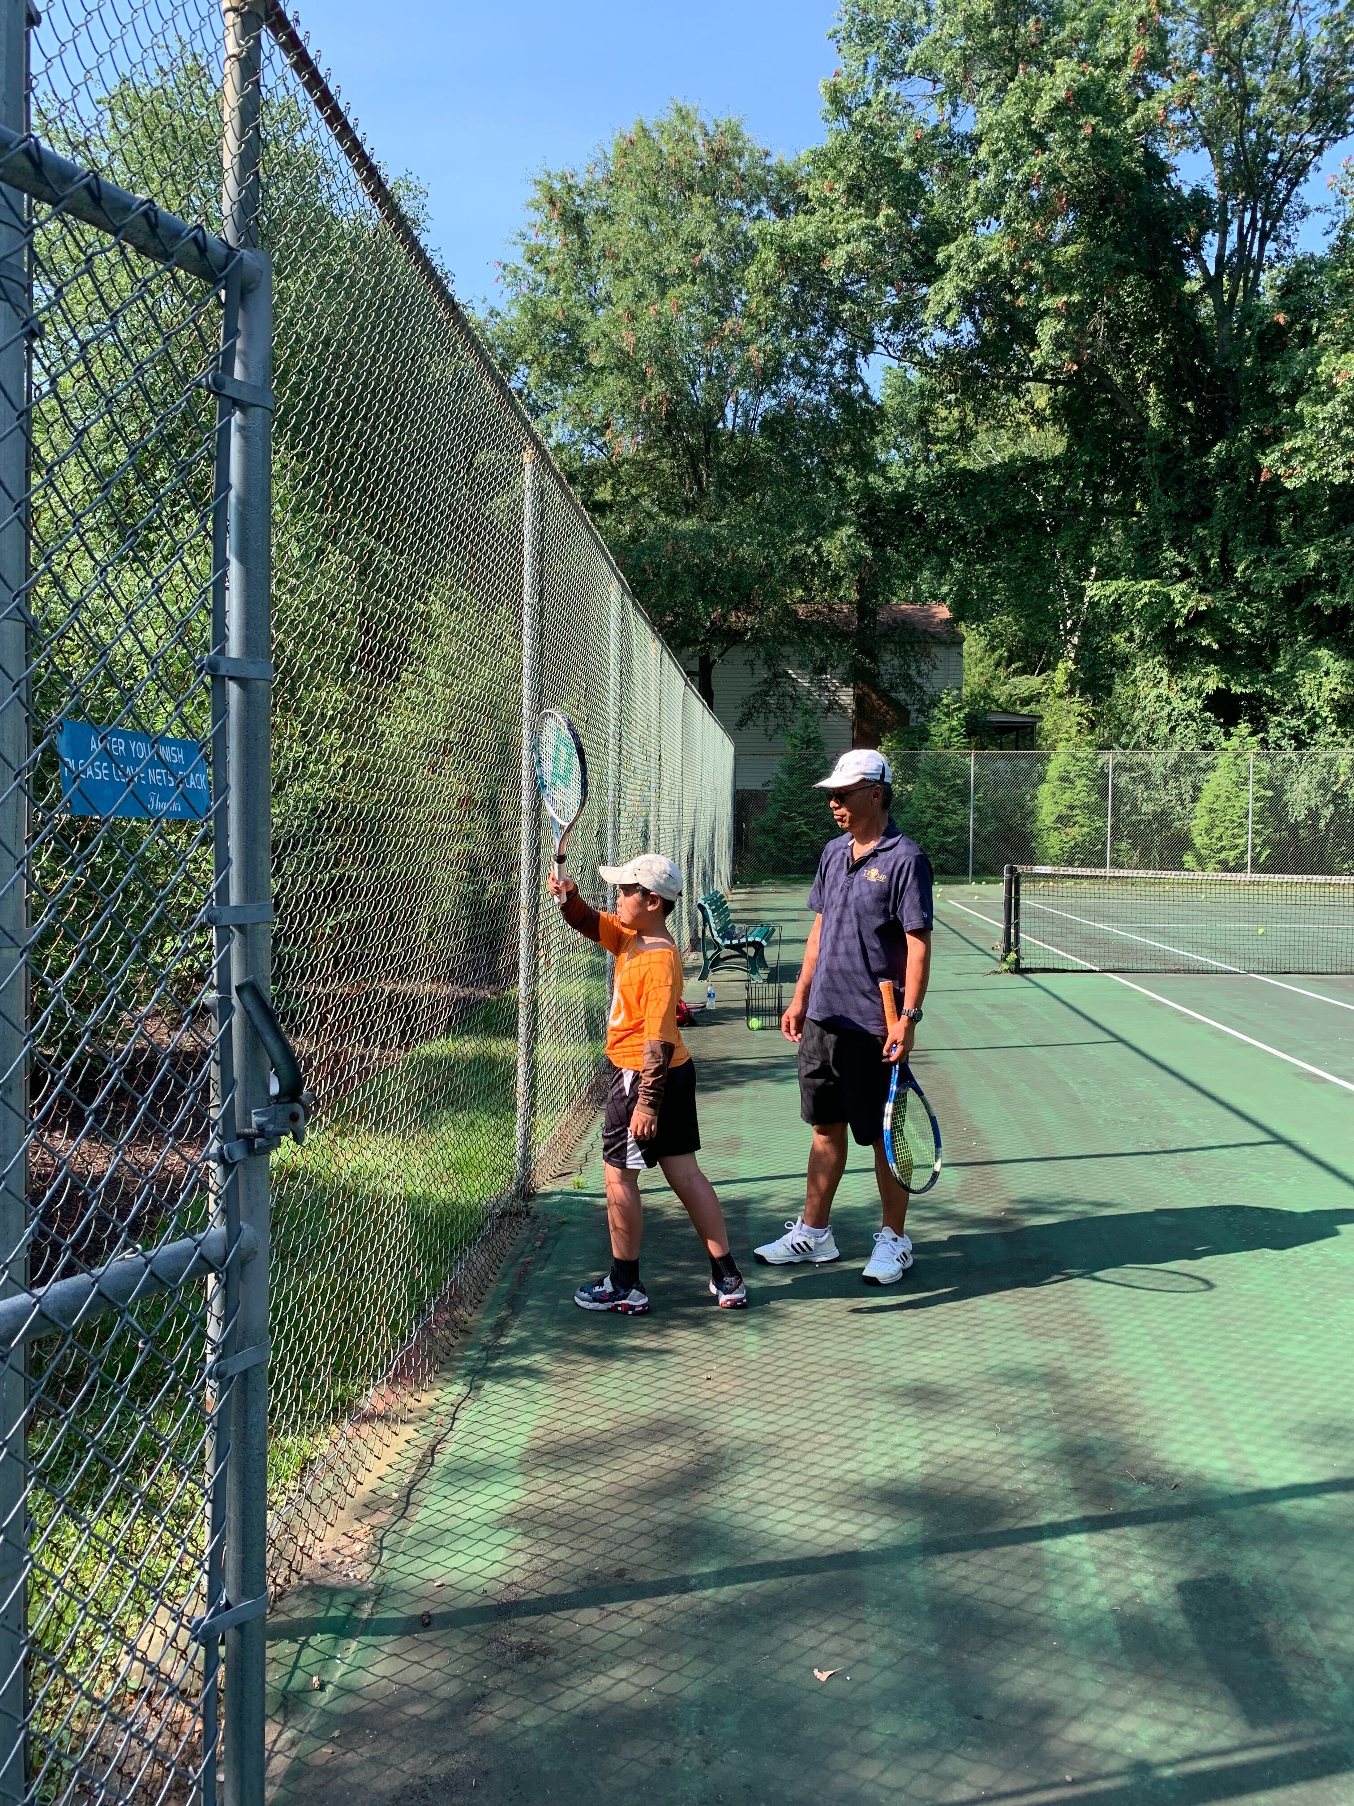
What’s up: 最近怎么样
Racket: 球拍
Tennis： 网球
Base line: 网球场边线
Form: 姿势
Challenging: 有挑战性
A: Hey, buddy, what's up?
B: I’ve been busy learning tennis. It requires more techniques than I thought.
A: I hear people say the same. It looks easy but hard to do.
B: Yeah, you tend to put a lot of power and swing too much. At the beginning, getting the form right is more important than hitting the ball hard.
B: Good to know. It sounds fun and challenging.

Slide 12
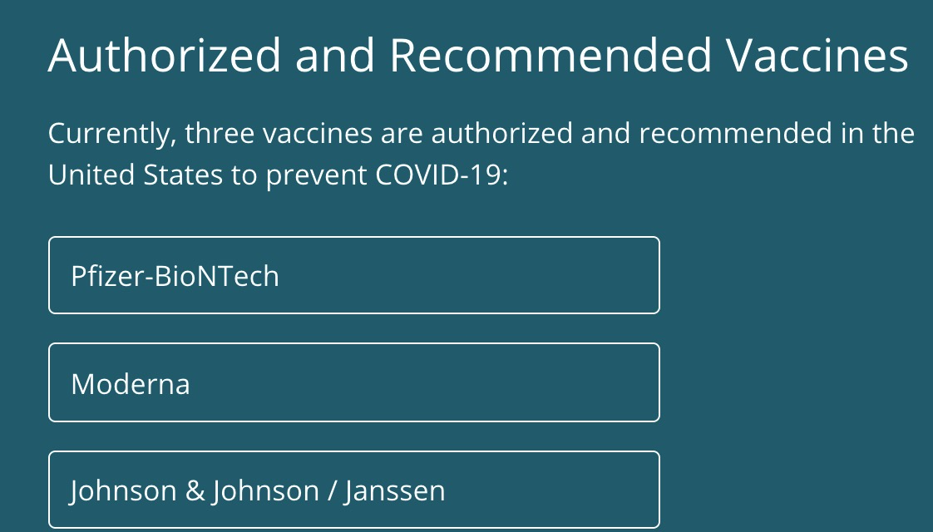
A: Is COVID-19 vaccine available for all ages?
B: Everyone 12 years of age and older is now eligible to get a COVID-19 vaccination.
A: Is it normal to get a fever after the COVID-19 vaccine?
B: In most cases, discomfort from pain or fever is a normal sign that your body is building protection. Contact your doctor or healthcare provider if you have concerns.
Vaccine: 疫苗
COVID-19： 新冠
Discomfort: 各种不适
Protection： 保护
Health provider: 医护工作者

Slide 13
A: Hey, any plans for this weekend?
B: Not really. Do you have any suggestions?
A: I’m going to pick peaches at Homestead farm. I heard people pick fruits and vegetables in local farms.
B: Sounds fun! Do you have the address for the local farms? Do I need to purchase tickets online ahead of time?
A: Yes, you do. They prefer for you to reserve online before you go. But you can just walk in.

Slide 14
A: Do you know anyone who has a used car for sale? I want to get one for my son who has just started learning to drive.
B: I can't think of anybody off the top of my head. I can ask my friends if you tell me what kind of car you’re looking for and your budget.
A: I heard Japanese cars have less issues, so I prefer either a Toyota or a Honda. Regarding price, I hope it’s less than $5000 but it depends on the condition of the car.
B: Got you. Let me check around and let you know.

Slide 15
A: You look amazing today! I really like your skirt. Where did you get it?
B: Thank you! I bought it from Amazon. Amazon is a great place to shop. It’s better than I expected. It fits me well and the quality of the material is good.
A: Nice! I might check online tonight to see if there is anything I like in Amazon.
B: Yes, do that. You can also try Macy’s or Marshalls if you prefer to shop in actual stores. Good luck!

Slide 16
A: Do you happen to know a good ear and nose doctor? My left ear hurts after I swam last week in my friend’s pool.
B: Oh, I’m sorry to hear that. Yes, I used to see an ear and nose doctor in Reston hospital who is a Korean. He knows what he is doing. I’ll pass his contact information to you.
A: Thank you so much! I hope I can get an appointment soon.
B: He is a specialist so you might need to wait for several weeks before you can get an appointment as you’re a new patient. For existing patients, usually they can get an appointment in the same day or the next 2-3 days.

