Slide 1
English Dialogues:
A: Can I help you? You seem lost.
B: Yeah, actually I am.
A: Where are you trying to go?
B: I’m trying to find the post office.

Slide 2
Can you tell me how to get to the post office?
… the museum
…the zoo
...the school
…the metro station
…the theater
I’m sorry. I don’t know
Sure. It’s not far from here.
Walk straight ahead.
It’s about two or three blocks.
It’s the first traffic light you come to then turn right.
You can’t miss it.

Slide 3
A: Do you think it will rain today?
B: Yeah, maybe. It’s hard to tell.
A: I hope not. I’m going to the beach this afternoon.
B: Maybe you should check the weather forecast first.
A: Good idea. I think I will.
B: Well, I hope you have a good afternoon.
A: You too, Frank.

Slide 4
A: Oh, hey. Did you have a good time hiking today?
B: Yes, although it was a bit hot.
A: That’s why I stayed inside.
B: What did you do?
A: I read a book.

Slide 5
A: Hello, how are you doing?
B: Not bad. Work is going well.
A: Oh, is it? That’s good to hear.
B: What about you?
A: I’m doing okay, although my car is in the shop.
B: Oh, really? That’s too bad.

Slide 6
A: What’s up, Andrew?
B: Not much. Not much at all.
A: Are you hungry?
B: A little bit. Do you want to eat?
A: Yes. Let’s go and find something to eat.
B: That sounds good to me.

Slide 7
A: Anyone up for a drink?
B: Sure, I could use a drink.
A: Me too. I really want a beer.
B: Where do you want to go?
A: I was thinking about going to that new place.
B: The one next to post office?
A: Yeah, I hear it’s pretty cheap.
B: Well, what are you waiting for? Let’s go.
A: Sounds good. After you.

Slide 8
A: Hi, I’m Marvin.
B: Marvin? My name is Julia.
A: I’m here to play basketball.
B: Good. We need more people to play.
A: I’m not very good.
B: That doesn’t matter. We’re just here for fun.

Slide 9
A: Mom, it looks like my flight is boarding.
B: Yes, I guess it is.
A: I should go now. I’ll call you when I land.
B: Yes, please do that. I want to know you’re safe.
A: Don’t worry so much. I have to go. I love you.
B: I love you, too. Bye dear.

Slide 10
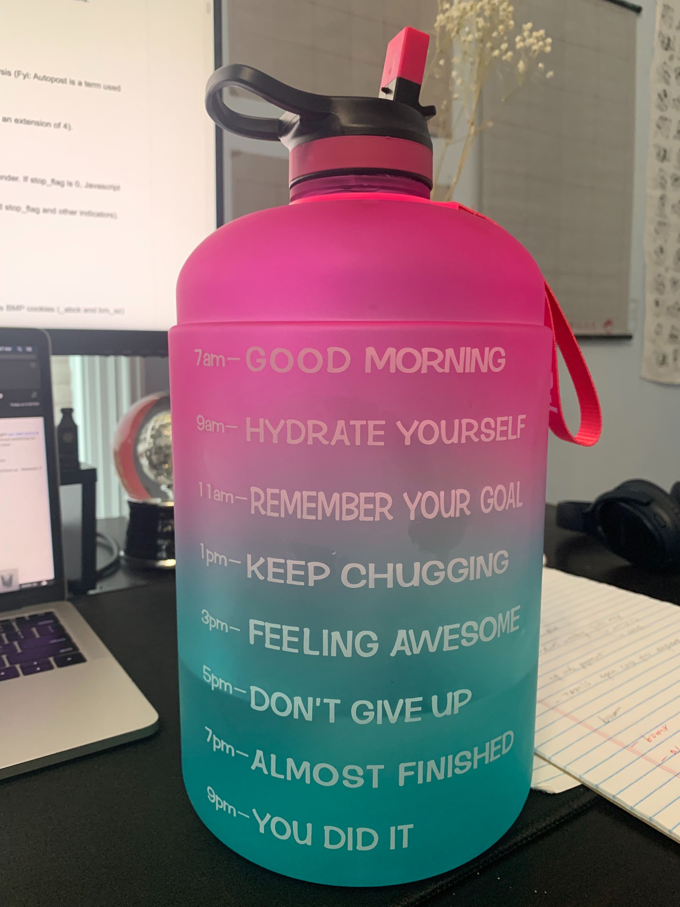
A: It’s so hot these days.
B: Yes, make sure you drink plenty water.
A: Agree. But sometimes I forget to drink water.
B: oh, do you know there is a bottle that can remind you to drink water?
A: Really? Nice. Where can I get it?
B: You can get it from Amazon.

Slide 11
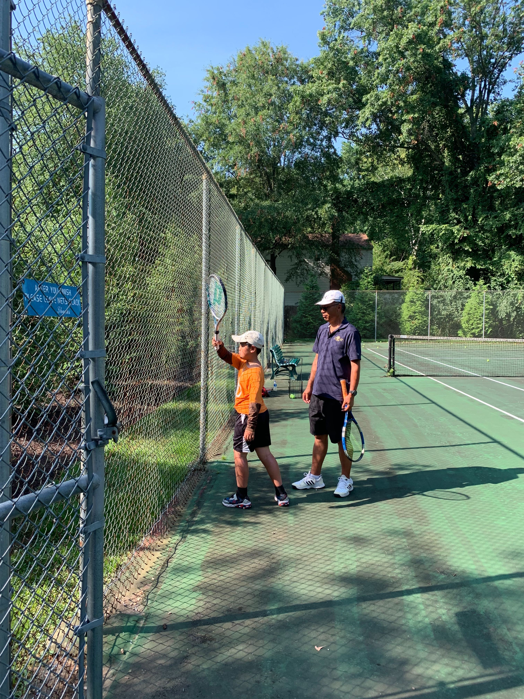
What’s up: 最近怎么样
Racket: 球拍
Tennis： 网球
Base line: 网球场边线
Form: 姿势
Challenging: 有挑战性
A: Hey, buddy, what's up?
B: I’ve been busy learning tennis. It requires more techniques than I thought.
A: I hear people say the same. It looks easy but hard to do.
B: Yeah, you tend to put a lot of power and swing too much. At the beginning, getting the form right is more important than hitting the ball hard.
B: Good to know. It sounds fun and challenging.

Slide 12
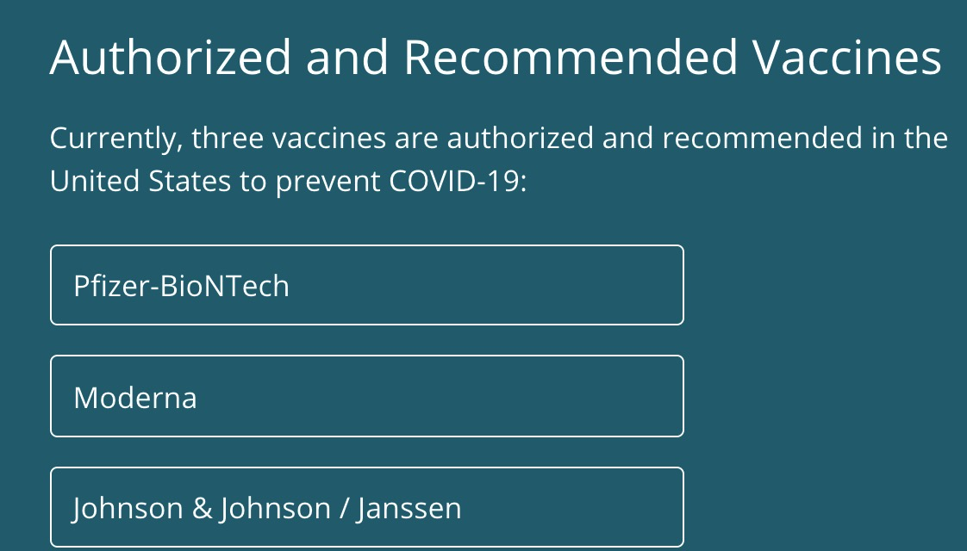
A: Is COVID-19 vaccine available for all ages?
B: Everyone 12 years of age and older is now eligible to get a COVID-19 vaccination.
A: Is it normal to get a fever after the COVID-19 vaccine?
B: In most cases, discomfort from pain or fever is a normal sign that your body is building protection. Contact your doctor or healthcare provider if you have concerns.
Vaccine: 疫苗
COVID： 新冠
Discomfort: 各种不适
Protection： 保护
Health provider: 医护工作者

