Slide 1
Circle of Love Helping parents speak better English

Slide 2
Agenda
“Circle or love” Parent English Learning Program Introduction
Instructor Team Introduction
Practice
Open Discussion

Slide 3
Circle of Love (CoL) Parent English Learning Program
To Parents:
Learn to speak English better
Role model of continuous learning
Close interaction with children
To Students:
Learn how to help parents
How to contribute to our community
Understand teachers better

Slide 4
CoL English Class Instructor Team
Teachers:
Michael H. Wang, 9th Grade, TJ High School
Matthew Palamarchuk, 9th Grade, TJ High School
Caroline Bean, 7th Grade, Mary Ellen Henderson
Lulu Huang, 9th Grade, TJ High School

Slide 5
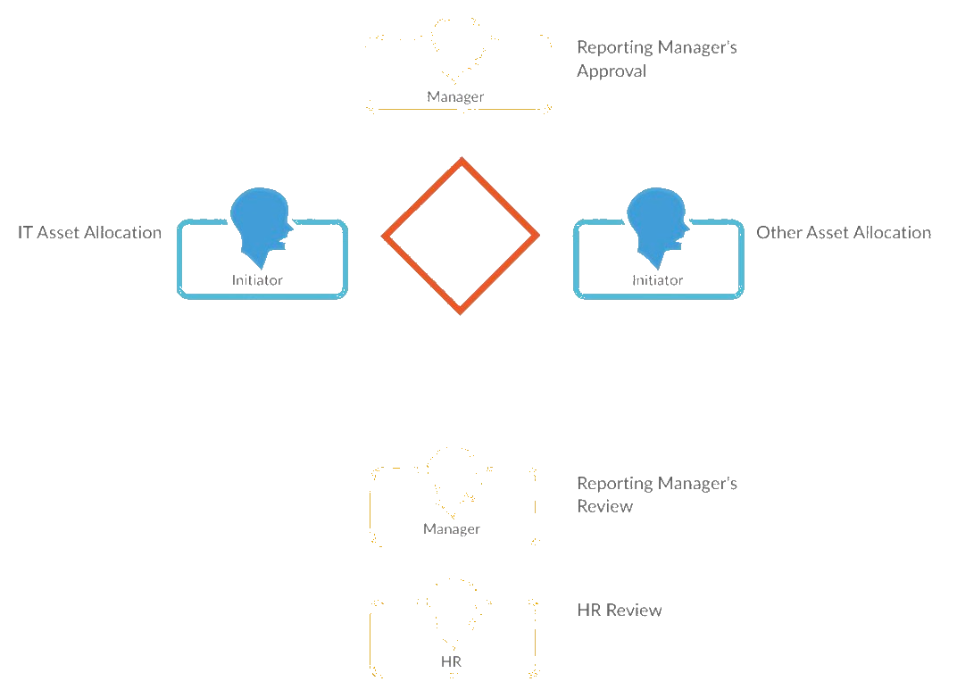
CoL English Class Practice Workflow
Pick a topic or online material
Instructors read a paragraph
Parents repeat the same paragraph
Instructors correct parents’ pronunciation
Word explanation or analysis

Slide 6
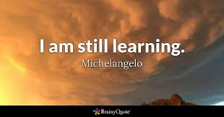
Famous Quotes of Learning
“Anyone who stops learning is old, whether at twenty or eighty. Anyone who keeps learning stays young. The greatest thing in life is to keep your mind young.” – Henry Ford
“Tell me and I forget, teach me and I may remember, involve me and I learn.” – Benjamin Franklin
“You don’t learn to walk by following rules. You learn by doing, and by falling over.” –Richard Branson “A man who asks is a fool for five minutes. A man who never asks is a fool for life.”
–Chinese Proverb

Slide 7
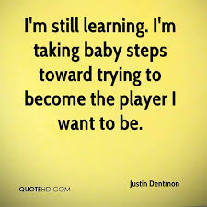
Famous Quotes of Learning
“Those people who develop the ability to continuously acquire new and better forms of knowledge that they can apply to their work and to their lives will be the movers and shakers in our society for the indefinite future.” – Brain Tracy.
“One hour per day of study in your chosen field is all it takes. One hour per day of study will put you at the top of your field within three years. Within five years you’ll be a national authority. In seven years, you can be one of the best people in the world at what you do.” – Earl Nightingale
“There is no end to education. It is not that you read a book, pass an examination, and finish with education. The whole of life, from the moment you are born to the moment you die, is a process of learning.” – Jiddu Krishnamurti

Slide 8
Famous Quotes of Love and Life
"Spread love everywhere you go. Let no one ever come to you without leaving happier."
-Mother Teresa
"If you set your goals ridiculously high and it's a failure, you will fail above everyone else's success."
-James Cameron
""Many of life's failures are people who did not realize how close they were to success when they gave up.”
-Thomas A. Edison
"In the end, it's not the years in your life that count. It's the life in your years.”
-Abraham Lincoln

Slide 9
Famous Quotes of Teamwork
1. “It takes two flints to make a fire.”
-Louisa May Alcott
2. “Coming together is a beginning. Keeping together is progress. Working together is success.”
-Henry Ford
3. “Alone we can do so little, together we can do so much.”
-Helen Keller
4. No one can whistle a symphony. It takes a whole orchestra to play it.”
-H.E. Luccock
5. “Remember, teamwork begins by building trust. And the only way to do that is to overcome our need for invulnerability.
-Patrick Lencioni

Slide 10
Famous Quotes of Teamwork
5. “Talent wins games, but teamwork and intelligence win championships.”
-Michael Jordan
6. “Teamwork is the ability to work together toward a common vision. The ability to direct individual accomplishments toward organizational objectives. It is the fuel that allows common people to attain uncommon results.”
-Andrew Carnegie
7. “You don’t need a new plan for next year. You need a commitment.”
-Seth Godin
8. “None of us, including me, ever do great things. But we can all do small things, with great love, and together we can do something wonderful.”
-Mother Teresa

