Slide 1
End of Year Part
December 19th, 2021
* Created by Jessie Jia
* The materials included here are for English class practice only. Please do not distribute.

Slide 2
Happy Holidays
2021 End of Year party

Slide 3
Merry Christmas and Happy New Year!

Slide 4
Riddles
What always goes up and never goes down?
Where do fishes store their money?
A word that starts with a “T”, Ends with a “T” and has “tea” in it. What is it?

Slide 5
Riddles

Slide 6
Riddles

Slide 7
Riddles

Slide 8
Riddles

Slide 9
Riddles

Slide 10
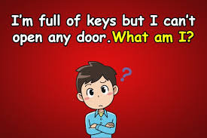
Riddles

