Slide 1
Advanced English Class
December 18, 2021
* Compiled by Sophie Zhang
* The materials included here are for English class practice only. Please do not distribute.

Slide 2
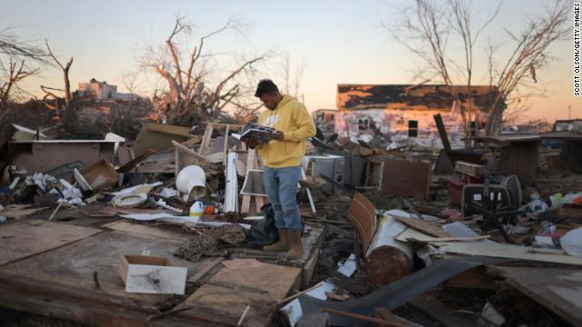
Kentucky, led by Governor Andy Beshear, is dealing with the aftermath of a series of tornadoes that killed dozens and caused widespread destruction. Several states were affected by the historic and deadly tornadoes that tore through the central and southern US, but Kentucky in particular has seen some of the worst damage.

Slide 3
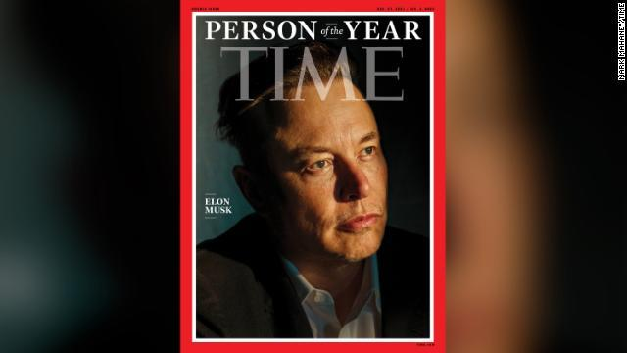
Elon Musk, billionaire, Tesla leader and space exploration proponent, was named Time magazine’s Person of the Year.

Slide 4
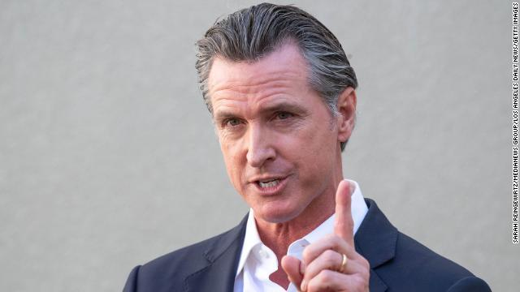
California Gov. Gavin Newsom says he is looking to draft a law similar to the Texas abortion bill, which would empower citizens to seek legal action against distributors of certain firearms.The California bill would allow private citizens to seek injunctive relief “against anyone who manufactures, distributes, or sells an assault weapon or ghost gun kit or parts in the State of California.”

Slide 5
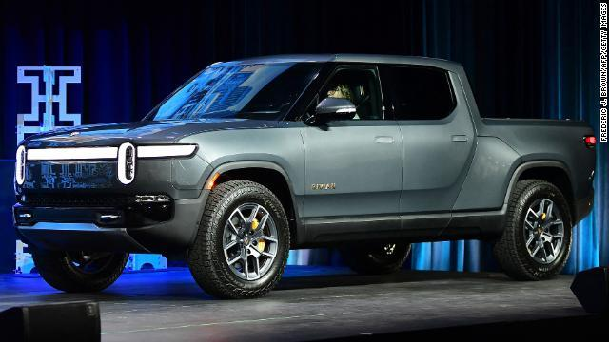
The electric car company Rivian won the MotorTrend 2022 Truck of the Year Award. The award was given to Rivian for its R1T pickup truck, making it the first truck not manufactured by one of Detroit’s ‘Big Three’ automakers to win the award since 2008.

Slide 6
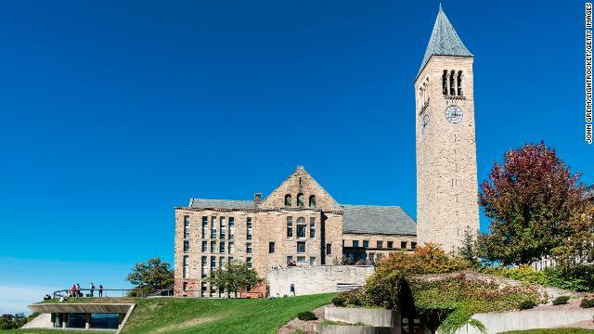
Cornell University reported a campus-wide outbreak of Covid-19 that they say is made up of a “very high percentage” of Omicron variant cases. Cornell University reported the outbreak and has moved to full remote learning, including the facilitation of final semester exams online for its more than 25,000 students.

Slide 7
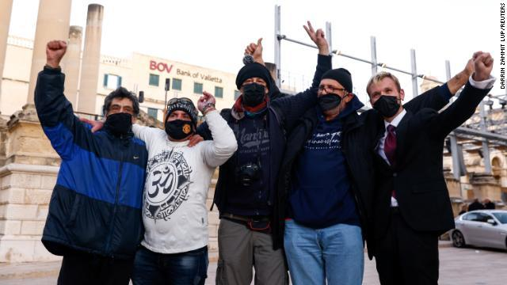
Malta will become the first in the European Union to legalize cannabis for recreational use. Malta is the first in the European Union to legalize recreational cannabis use in a limited capacity for adults 18 and over.

Slide 8
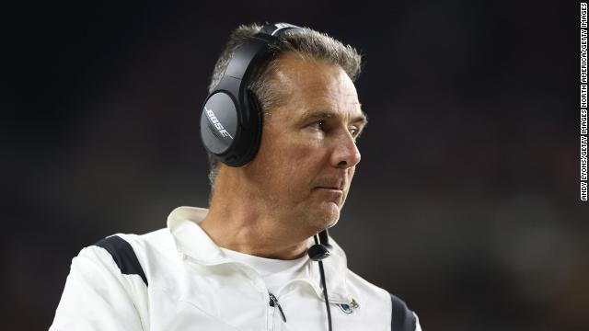
The NFL team San Francisco 49ers has fired head coach Urban Meyer after less than one season on the job. NFL team has fired head coach Urban Meyer after less than one season on the job.

Slide 9
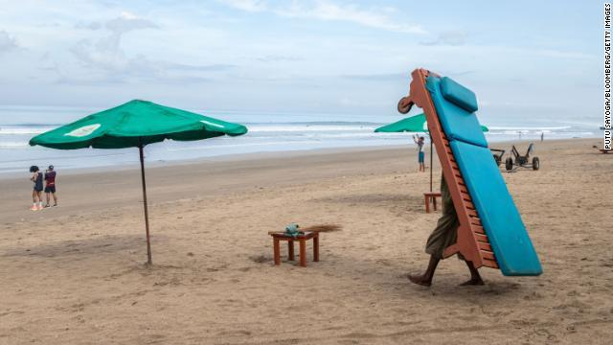
Bali usually attracts millions of tourists a year, welcomed only 45 international visitors in 2021. Bali received only 45 international visitors in 2021 due to strict coronavirus restrictions.

Slide 10
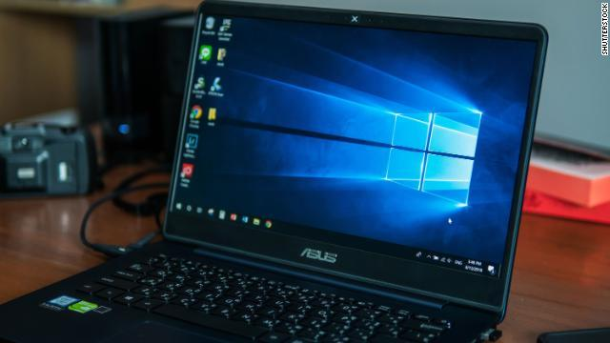
Microsoft said that international hackers are working to exploit a critical flaw in a widely-used software known as “Log4j.” The software in question logs information for different applications.The Java-based Log4j software is used by organizations around the world to log information in their applications. The vulnerability could affect hundreds of millions of devices around the globe.

Slide 11
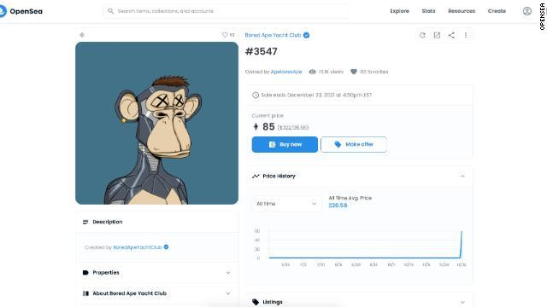
A digital art NFT recently commanded attention when it was accidentally sold for $2,844 — nearly $280,000 under its estimated value. NFT stands for “non-fungible token,” and is a type of tradeable, digital art linked to cryptocurrency and blockchain technology.

Slide 12
Quotes on Teamwork
Talent wins games, but teamwork and intelligence win championships. Michael Jordan
Coming together is a beginning. Keeping together is progress. Working together is success. Henry Ford
Alone we can do so little, together we can do so much. Helen Keller
I invite everyone to choose forgiveness rather than division, teamwork over personal ambition.”
Jean-Francois Cope

Slide 13
None of us is as smart as all of us. Ken Blanchard
None of us, including me, ever do great things. But we can all do small things, with great love, and together we can do something wonderful. Mother Teresa
None of us, including me, ever do great things. But we can all do small things, with great love, and together we can do something wonderful.
Mother Teresa

Slide 14
Source:
CNN Times Weekly News
https://www.goodreads.com/quotes/tag/gratitude

