Slide 1
Advanced English Class
December 11, 2021
* Compiled by Sophie Zhang
* The materials included here are for English class practice only. Please do not distribute.

Slide 2
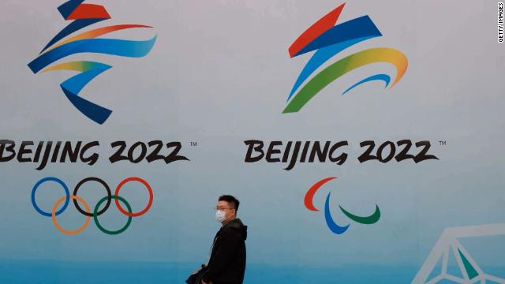
The Biden administration announced a diplomatic boycott of the 2022 Winter Olympics that will take place in Beijing. Though US athletes will still compete, the Biden administration is joining other select countries in not sending an official delegation to the 2022 Winter Olympics in Beijing in protest of human rights violations in the country’s Xinjiang province.

Slide 3
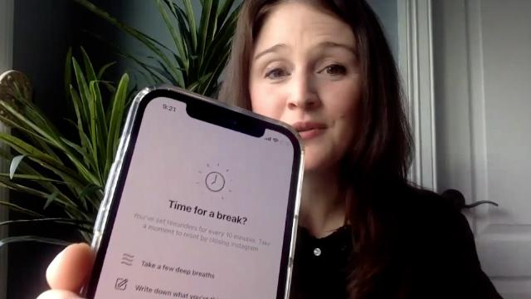
The social media company Instagram recently rolled out a “Take a Break” tool, which deters people from spending endless hours scrolling on the platform. The Instagram feature launched the same week that the company’s head, Adam Mosseri, testified at a Senate hearing over the app’s effects on mental health.

Slide 4
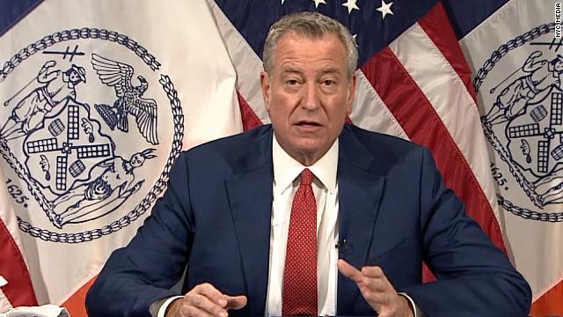
New York city announced that all private sector employers there will be required to implement a Covid-19 vaccine mandate? This new directive means all employees working in the city must be vaccinated, and it’s the first major city-wide mandate of its kind. New York City’s mayor Bill de Blasio announced the mandate, and companies are required to implement the new policy by December 27.

Slide 5
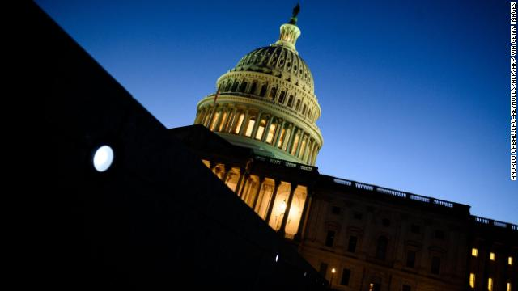
The House of Representatives passed a bipartisan bill authorizing $770 billion in funding for national defense and security. The bill, known as the National Defense Authorization Act, is part of annual legislation that sets the policy agenda and provides funding for the Department of Defense.

Slide 6
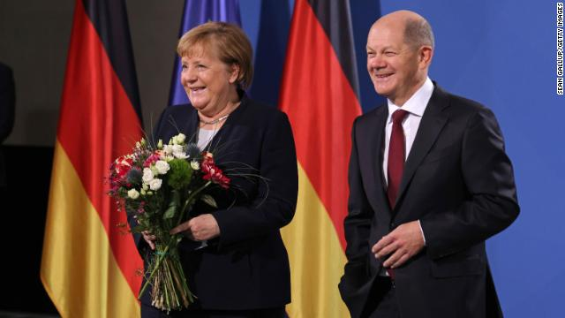
Germany just appointed a new leader, marking a major changing of the guard for one of the world’s largest economies. Germany voted in Olaf Scholz as its new chancellor, replacing Angela Merkel, who held the position for 16 years.

Slide 7
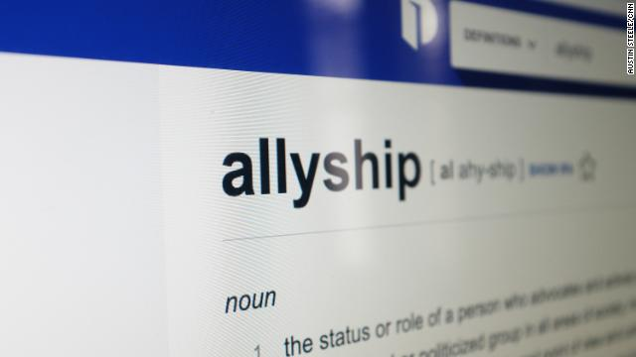
Dictionary.com has announced its Word of the Year that they say encompasses the defining events of 2021. It is “allyship”. Dictionary.com’s word of the year is allyship, a word that the company says “acts as a powerful prism through which to view the defining events and experiences of 2021” – from the social justice causes to those serving the front lines of the pandemic.

Slide 8
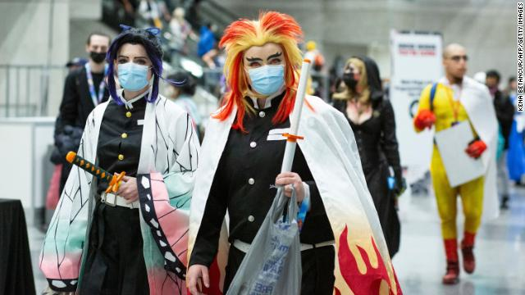
The recent New York City event - an anime convention may provide an early look into the transmissibility of the Omicron coronavirus variant, according to CDC experts. CDC Director Dr. Rochelle Walensky said that Anime NYC, a November convention with an estimated attendance of 53,000, could be pivotal in understanding the variant’s earliest spread in the US.

Slide 9
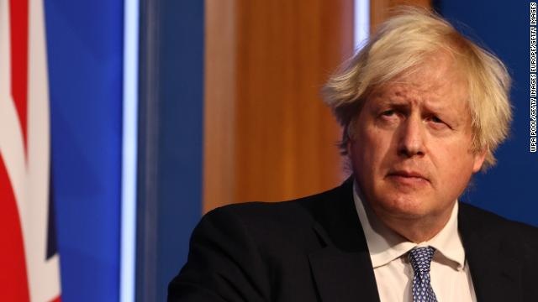
UK Prime Minister Boris Johnson is embroiled in controversy following allegations that two social events were held in one of the country’s main government buildings in the days leading up to Christmas last year. UK Prime Minister Boris Johnson and his team have received strong condemnation after information and videos emerged seeming to reference Christmas parties that took place at 10 Downing Street when the country was under strict coronavirus restrictions.

Slide 10
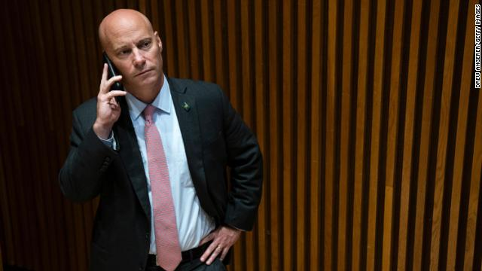
Marc Short, a member of the former Trump administration, is cooperating with the House committee investigating the January 6 Capitol riot. The committee hopes to use Short to gain insight into the actions of Mike Pence, whom Short served under. Short was the chief of staff to former Vice President Mike Pence.

Slide 11
Quotes on Community Service
“One of the most important things you can do on this earth is to let people know they are not alone.” ― Shannon L. Alder
“Remember that the happiest people are not those getting more, but those giving more.” ― H. Jackson Brown Jr.
“We all need to be reminded that democracy isn't just voting for the president every four years and then trusting him to fix things. Democracy is about getting together with your community to think together about your future.” ― Bill McKibben, Radio Free Vermont: A Fable of Resistance
“One person caring for one neighborhood, that's how we'll change the world, not with policy and policing.” ― Abhijit Naskar, Şehit Sevda Society: Even in Death I Shall Live
“Most people aren’t lazy; they just need a little push to get going.” ― Michael Bassey Johnson, Before You Doubt Yourself: Pep Talks and other Crucial Discussions

Slide 12
“Volunteers don’t get paid, not because they’re worthless, but because they’re priceless.” – Sherry Anderson
“The smallest act of kindness is worth more than the grandest intention.” – Oscar Wilde
“As you grow older, you will discover that you have two hands — one for helping yourself, the other for helping others.” — Audrey Hepburn
“You may not have saved a lot of money in your life, but if you have saved a lot of heartaches for other folks, you are a pretty rich man.” – Seth Parker
“Life’s most persistent and urgent question is, What are you doing for others?” — Martin Luther King, Jr.
“Our generation has the ability and the responsibility to make our ever-more connected world a more hopeful, stable and peaceful place.” — Natalie Portman

Slide 13
“The meaning of life is to find your gift. The purpose of life is to give it away.” — William Shakespeare
“The unselfish effort to bring cheer to others will be the beginning of a happier life for ourselves.” — Helen Keller
“No one is more cherished in this world than someone who lightens the burden of another.” – Author Unknown

Slide 14
Source: CNN Times Weekly News https://www.goodreads.com/quotes/tag/gratitude

