Slide 1
Advanced English Class
December 4, 2021
* Compiled by Sophie Zhang
* The materials included here are for English class practice only. Please do not distribute.

Slide 2
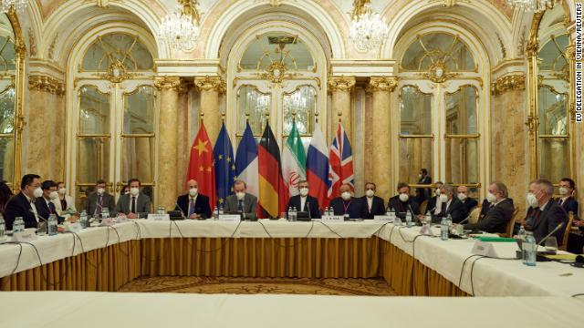
The US and its allies have restarted talks concerning the nuclear capabilities of Iran. After halting negations during the Trump administration, the US is looking to restart nuclear talks with Iran and re-enter the Iran nuclear agreement.

Slide 3
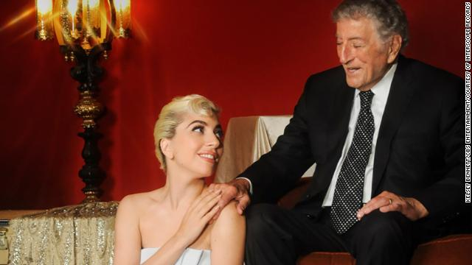
The beloved American singer Tony Bennett celebrated his last onstage performance at Radio City Music Hall in New York City at the spry age of 95. Joined by Lady Gaga, Tony Bennett performed onstage for what will reportedly be the last time.

Slide 4
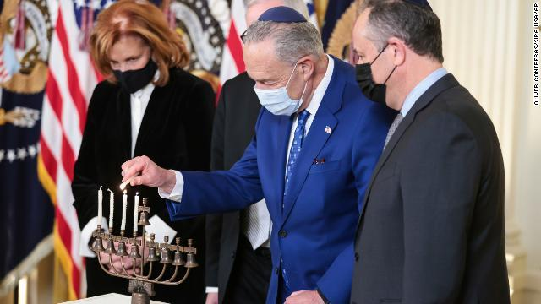
Jewish people around the world began the celebration of Hannukah this week. Nine candles are typically on a Hannukah menorah. Hannukah menorahs usually contain nine candles: eight sacred lights and one central light to light the others (sometimes, there is no central light, making eight candles). The eight sacred lights represent the eight nights that the stores of oil burned after the liberation of the sacred Temple in Jerusalem.

Slide 5
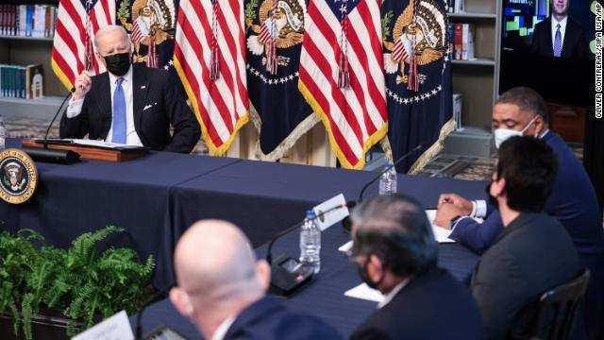
President Joe Biden recently met with CEOs from the retail industry to discuss challenges brought on by the holiday season. On Cyber Monday, Biden met with the leaders of a number of retailers and grocers, including the CEOs of Best Buy, Food Lion and Walmart, to discuss how to keep items on shelves for holiday buyers.

Slide 6
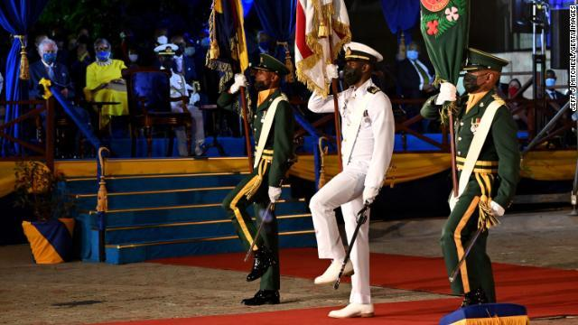
The island nation of Barbados just cut its last remaining ties with the British monarchy after 400 years. Barbados made the transition from realm to republic. The nation now no longer recognizes Queen Elizabeth as its head of state. Instead, they inaugurated their first president; former Governor-General Sandra Mason.

Slide 7
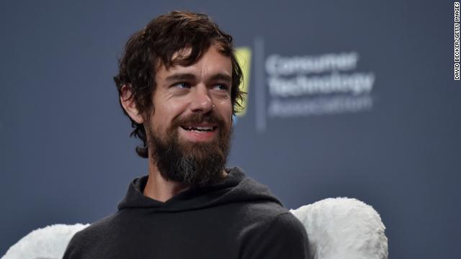
The CEO of the major tech company Twitter stepped down this week.
Jack Dorsey, cofounder and public face of Twitter, stepped down as the company’s CEO, but says he will remain part of the company’s board until at least next year.

Slide 8
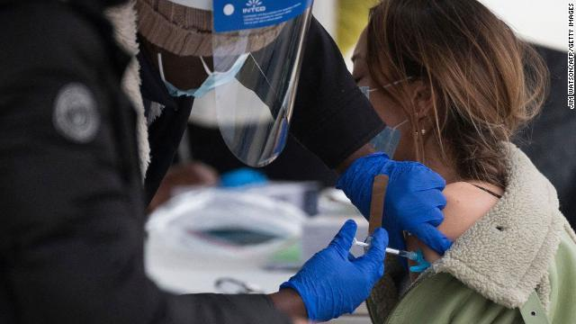
The word “Vaccine” is Merriam-Webster’s 2021 Word of the Year. Merriam-Webster announced “vaccine” as the 2021 Word of the Year – the word selected based on lookup data, notable spikes, and year-over-year increases in searches.

Slide 9
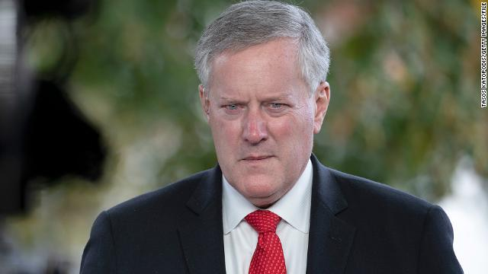
Mark Meadows is now reportedly cooperating with the House select committee investigating the January 6th riot after initially defying a subpoena. As then-President Donald Trump’s chief of staff, House investigators view Meadows as a key individual in piecing together the events of January 6th insurrection at the US Capitol.

Slide 10
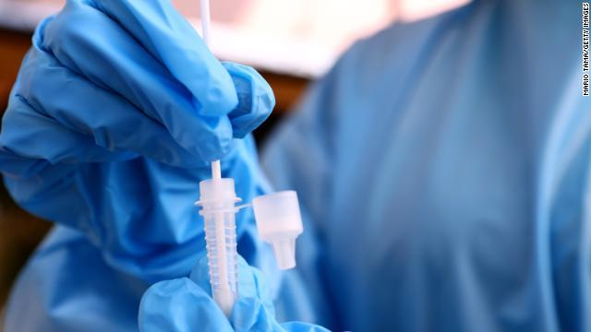
The first known case of the Omicron coronavirus was just detected in the US. The first US-based case was confirmed in San Francisco, California, in a patient who had recently returned from South Africa.

Slide 11
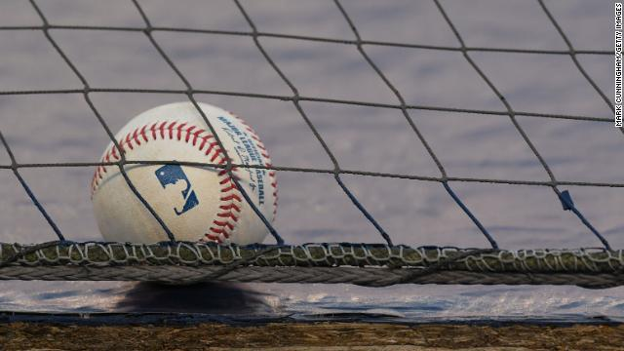
Major League Baseball entered a work stoppage after failing to reach a new collective bargaining agreement with its players’ union. This is the first MLB work stoppage since the infamous 1994-1995 player strike.

Slide 12
Quotes on Gratitute
“Let us be grateful to the people who make us happy; they are the charming gardeners who make our souls blossom.” ― Marcel Proust
“Dare to Be When a new day begins, dare to smile gratefully. When there is darkness, dare to be the first to shine a light. When there is injustice, dare to be the first to condemn it. When something seems difficult, dare to do it anyway. When life seems to beat you down, dare to fight back. When there seems to be no hope, dare to find some. When you’re feeling tired, dare to keep going. When times are tough, dare to be tougher.

Slide 13
When love hurts you, dare to love again. When someone is hurting, dare to help them heal. When another is lost, dare to help them find the way. When a friend falls, dare to be the first to extend a hand. When you cross paths with another, dare to make them smile. When you feel great, dare to help someone else feel great too. When the day has ended, dare to feel as you’ve done your best. Dare to be the best you can – At all times, Dare to be!” ― Steve Maraboli, Life, the Truth, and Being Free

Slide 14
Source: CNN Times Weekly News https://www.goodreads.com/quotes/tag/gratitude

