Slide 1
Advanced English Class
November 20, 2021
* Compiled by Sophie Zhang
* The materials included here are for English class practice only. Please do not distribute.

Slide 2
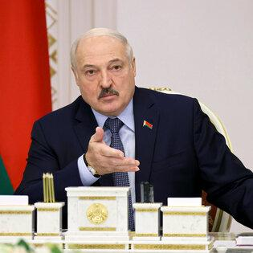
E.U. officials have accused Belarus’s president of manufacturing a continuing migrant crisis on the bloc’s eastern border. Belarus’s autocratic leader and his government appears to have orchestrated the current migrant crisis by encouraging or even shepherding visitors from places like Iraq and Syria to the borders of E.U. member countries.

Slide 3
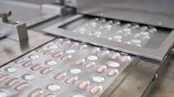
Pfizer this week asked the F.D.A. to authorize an antiviral Covid pill. Pfizer requested emergency use authorization for its Covid pill, which studies found greatly reduced the risk of severe infection. The U.S. plans to buy enough Pfizer pills to treat 10 million people, and a similar drug developed by Merck could be authorized next month.

Slide 4
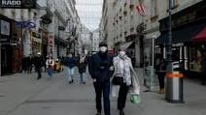
Coronavirus cases and deaths have spiked across Europe in the past two months. Austria announced this week that it would require unvaccinated residents to remain home except for essential activities. In Austria, unvaccinated people ages 12 and older are now largely confined to their homes. This is one of the strictest coronavirus lockdowns in Europe. About 65 percent of Austria’s 8.9 million people are vaccinated.

Slide 5
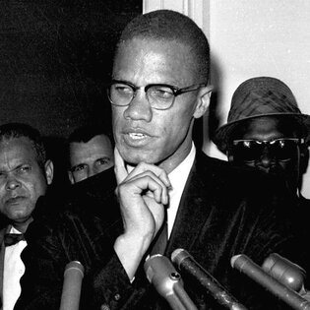
A New York judge exonerated two men who were convicted of assassinating Malcolm X. Two men convicted in his 1965 murder, each spent more than 20 years in prison. But an inquiry by their lawyers and the Manhattan district attorney’s office found that prosecutors, the F.B.I. and the New York Police Department withheld exonerating evidence.

Slide 6
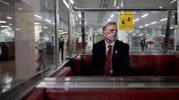
The House of Representatives censured Paul Gosar, an Arizona republican this week for tweeting a violent video. Gosar is a six-term far-right congressman who posted an anime video edited to depict him killing Ocasio-Cortez and swinging two swords at President Biden. The House, which voted mostly along party lines, also stripped Gosar of his committee assignments.

Slide 7
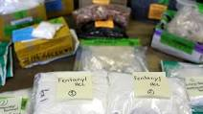
More than 100,000 Americans died of overdoses in a 12-month span that ended in April. Annual overdose deaths have roughly doubled since 2015 as fentanyl, a deadly synthetic opioid, has become more common. Last year was the first time the total surpassed 100,000 — more than the combined toll of gun violence and car crashes.

Slide 8
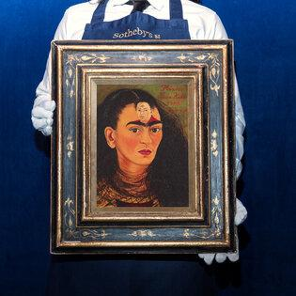
The self-portrait of Frida Kahlo was sold this week for $34.9 million. The painting, titled “Diego and I,” was completed late in Kahlo’s career and hints at her troubled marriage with the muralist Diego Rivera. It set a record for the most expensive work by a Latin American artist ever sold at auction.

Slide 9
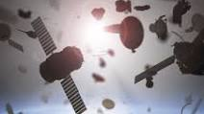
Astronauts aboard the International Space Station were forced to take shelter this week because debris from a Russian antisatellite missile test threatened the station. Russia’s missile test, which destroyed one of its own orbiting satellites, created a cloud of more than 1,500 pieces of debris and forced astronauts to seek refuge for hours in two spacecraft capable of returning them to Earth.

Slide 10
Adele’s fourth album arrived on Friday and it’s titled “30”. This is her fourth album and her first in six years. (Her others were titled “19,” “21” and “25.”) In a review, our critic wrote that Adele’s voice — “cooing, declaiming, arguing, teasing, imploring, quivering, breaking, shouting — is rightfully at the center.”

Slide 11
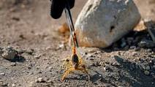
Scorpions swarmed into villages in southern Egypt late last week, stinging at least 503 people. Experts believe flash flooding was the cause. Heavy rain swept hundreds, if not thousands, of yellowish four-inch scorpions out of their desert burrows and into nearby villages.

Slide 12
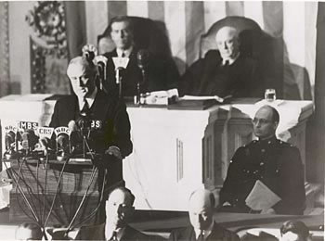
Franklin Delano Roosevelt, "Pearl Harbor Address to the Nation“
December 8, 1941; Washington, D.C.
The attack on Pearl Harbor, December 7, 1941, shocked the United States to its core, outraging a nation that had hoped to stay out of the mounting turmoil in Asia and Europe. Overnight, the country united in desire to enter the war. The day after the attacks, FDR addressed the nation in a brief, but electrifying speech, declaring war on Japan and giving assurance that the United States would attain victory.
Be sure to listen to the audio of the speech. Imagine every American family, rattled and worried, listening around the radio to what their president would say. They knew their whole world was about to change forever. Listen to the reaction of Congress as they applaud and cheer FDR's words. The emotion is so very real and palatable; it truly transports you back to that critical moment in time.

Slide 13
“Mr. Vice President, Mr. Speaker, members of the Senate and the House of Representatives: yesterday, December 7, 1941-a date which will live in infamy-the United States of America was suddenly and deliberately attacked by naval and air forces of the Empire of Japan.....
But always will our whole nation remember the character of the onslaught against us. No matter how long it may take us to overcome this premeditated invasion, the American people in their righteous might will win through to absolute victory.
I believe that I interpret the will of the Congress and of the people when I assert that we will not only defend ourselves to the uttermost but will make it very certain that this form of treachery shall never again endanger us.
Hostilities exist. There is no blinking at the fact that our people, our territory and our interests are in grave danger.
With confidence in our armed forces-with the unbounding determination of our people-we will gain the inevitable triumph-so help us God.”

Slide 14
Source: NY Times Weekly News https://www.artofmanliness.com/character/knowledge-of-men/the-35-greatest-speeches-in-history/

