Slide 1
Advanced English Class
October 30, 2021
* Compiled by Sophie Zhang
* The materials included here are for English class practice only. Please do not distribute.

Slide 2
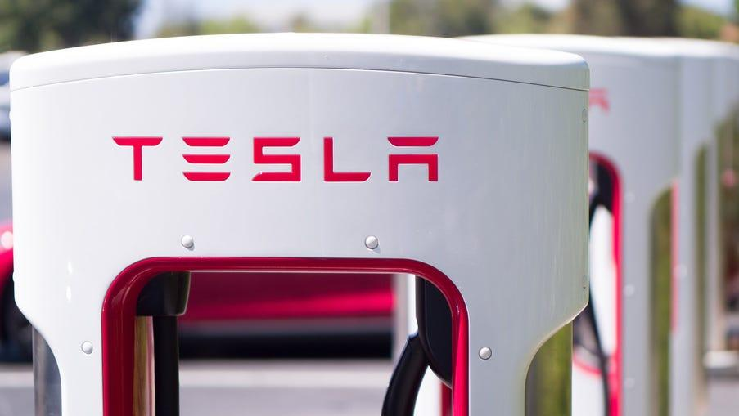
Tesla’s market value reached $1 trillion this week, becoming the fifth company to do so.
.

Slide 3
Brooklyn-based collective MSCHF is putting up an Andy Warhol sketch valued at about $20,000 for $250. However, it is selling:

Slide 4
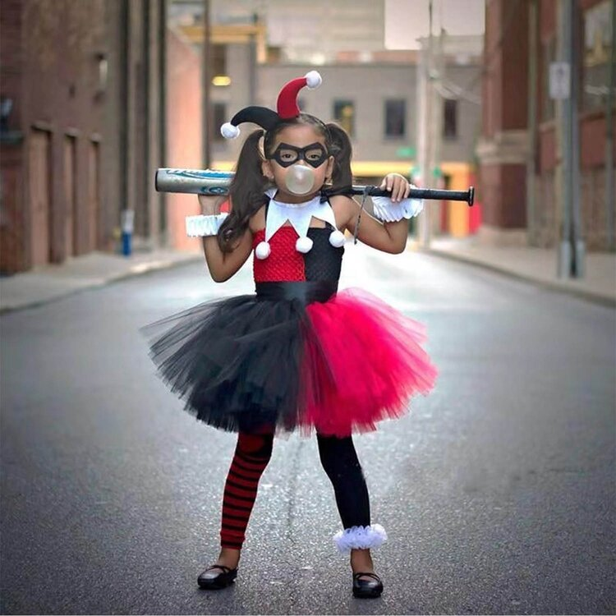
Harley Quinn is one of the top 10 costumes in the U.S. this year, according to Google Trends.

Slide 5
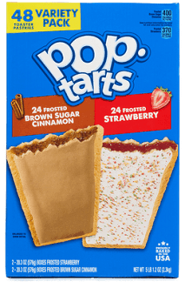
A $5 million class-action lawsuit alleges that Kellogg’s doesn’t put enough strawberries in Pop-Tarts.

Slide 6
Only 40% of Americans know vaccinated people are less likely to test positive for COVID-19, per an Axios/Ipsos poll?

Slide 7
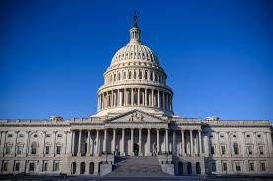
Congress has headed out for the week without officially coming to an agreement about either the Democratic spending bill or the bipartisan infrastructure bill despite enormous pressure to seal some deals before President Biden's European trip.

Slide 8
Facebook is changing its company name to ... Meta. Facebook will still exist, of course, but only as one product under the larger company umbrella. The rebranding signals the company's growing interest in the "metaverse," which would combine virtual and augmented reality into a new kind of online realm. It could also help distract from growing criticism about the impact of its social media platforms.

Slide 9
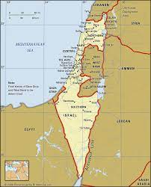
Israel's plan to green-light thousands of new Israeli housing units in the West Bank is drawing international criticism. Such settlements are illegal under international law because both the West Bank and East Jerusalem are considered occupied territory -- which Israel disputes. Twelve European countries yesterday urged Israel to "reverse its decision." The US and the UK also issued strong disagreements with the plan.

Slide 10
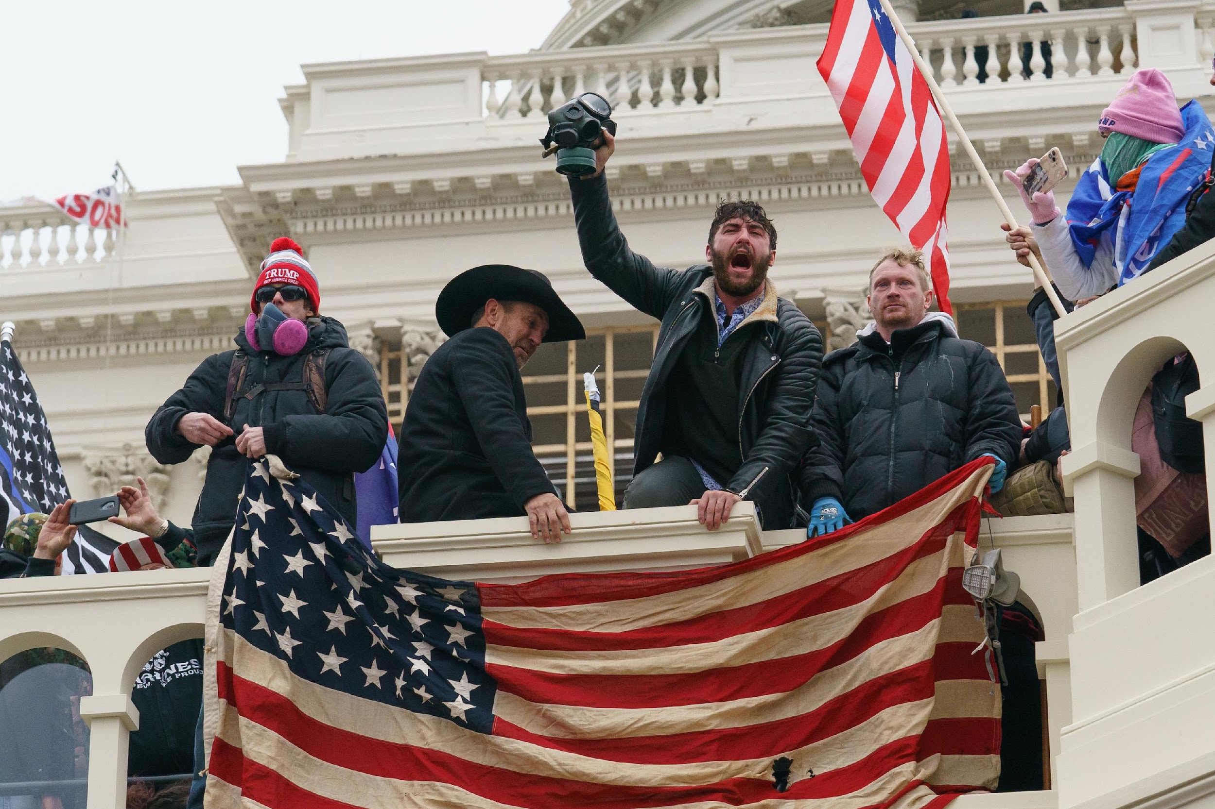
Members of the House select committee investigating the January 6 Capitol riot are losing patience with former White House Chief of Staff Mark Meadows and may resort to charges of criminal contempt to get him to appear.

Slide 11
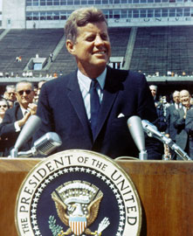
John F. Kennedy, "The Decision to Go to the Moon"
May 25, 1961; Houston, TX
On April 12, 1961, the Soviets launched the first man into space. Soviets used this triumph as prime evidence of communism's superiority over decadent capitalism. Embarrassed, the United States feared it was falling behind the Soviet Union and losing the "space race." After consulting with political and NASA officials, Kennedy decided it was time for America to boldly go where no man had gone before by putting a man on the moon. The feat would not only catapult the nation over the Soviet Union, but also allow man to more fully explore the mysteries of space. And this mission would be accomplished by the end of the 1960's. When was the last time a president publicly issue a straightforward, ambitious goal and set a timeline for its success?

Slide 12
“There is no strife, no prejudice, no national conflict in outer space as yet. Its hazards are hostile to us all. Its conquest deserves the best of all mankind, and its opportunity for peaceful cooperation many never come again. But why, some say, the moon? Why choose this as our goal? And they may well ask why climb the highest mountain? Why, 35 years ago, fly the Atlantic? Why does Rice play Texas?
We choose to go to the moon. We choose to go to the moon in this decade and do the other things, not because they are easy, but because they are hard, because that goal will serve to organize and measure the best of our energies and skills, because that challenge is one that we are willing to accept, one we are unwilling to postpone, and one which we intend to win, and the others, too.”

Slide 13
Source: CNN Weekly News

