Slide 1
Advanced English Class
October 23, 2021
* Compiled by Sophie Zhang
* The materials included here are for English class practice only. Please do not distribute.

Slide 2
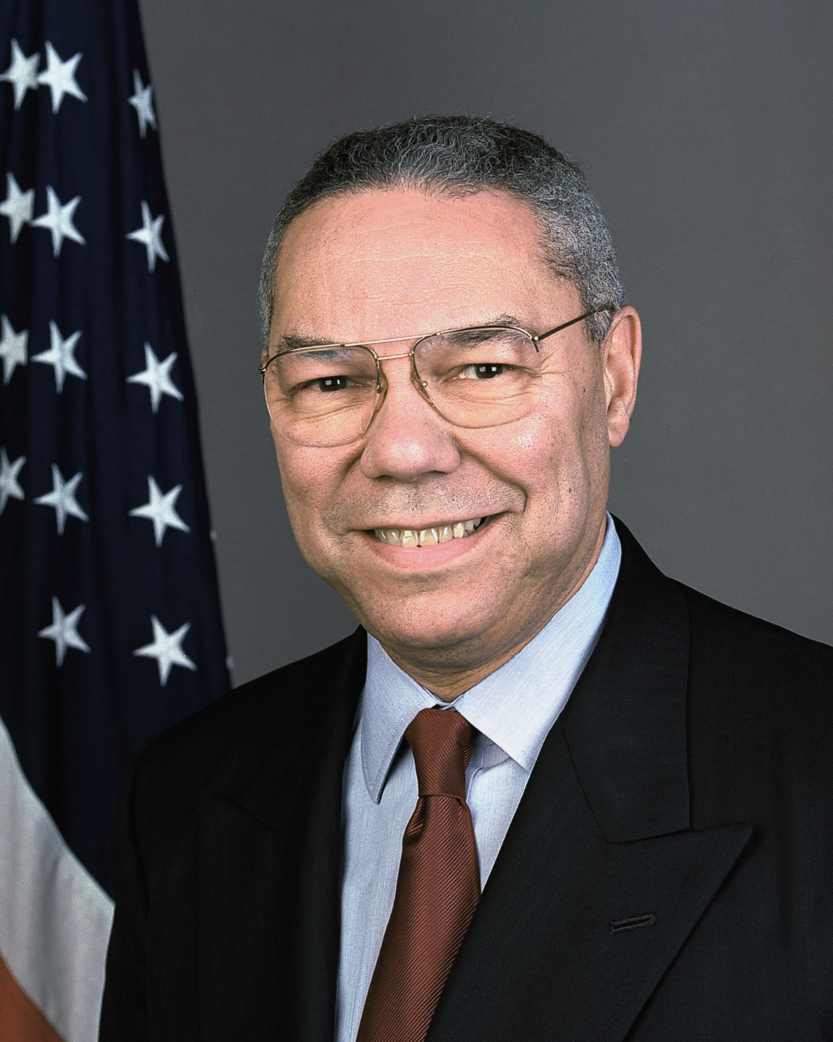
Colin Powell died this week at 84. Powell was the country’s first Black national security adviser, chairman of the Joint Chiefs of Staff and secretary of state, but he decided not to run for president after getting courted by both Republicans and Democrats in the 1990s.

Slide 3
The F.D.A. authorized — and the C.D.C. endorsed — the mixing and matching of different types of Covid vaccines. Carl Zimmer explains why the science behind the move is promising.

Slide 4
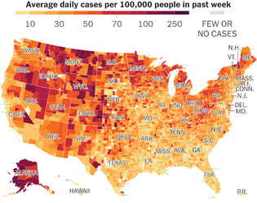
In the past week, Mountain West has led the U.S. in new Covid cases per capita. While much of the country continues to see improvement, Montana, Idaho and Wyoming have been struggling, leading the country in recent cases per capita.

Slide 5
A congressional panel in Brazil recommended that President Jair Bolsonaro be charged with "crimes against humanity" for letting the coronavirus spread in a failed bid for herd immunity. The 11-member panel recommended criminally charging Bolsonaro for discouraging masks, delaying a vaccine rollout and other policies it said had led to the deaths of more than 300,000 Brazilians, half the country’s total Covid death toll.

Slide 6
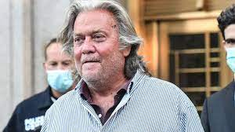
The House found the former Trump administration official Steve Bannon in criminal contempt of Congress after he defied a subpoena. The former White House counselor to Donald Trump refused to turn over documents or testify to the committee investigating the Jan. 6 Capitol attack. The Justice Department must now determine whether to prosecute him.

Slide 7
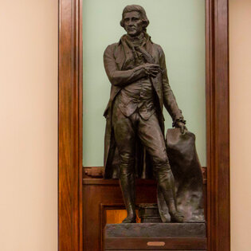
New York City officials this week voted to remove a statue of Thomas Jefferson from the City Council chamber. On Monday, city officials voted unanimously to remove the statue from Council chambers after some members cited Jefferson’s history as a slaveholder and called for the statue to be banished.

Slide 8
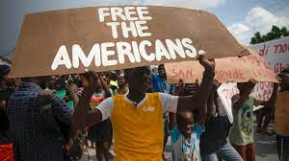
Gang members kidnapped 17 people from a U.S.-based group working in Haiti. They are a part of Christian missionaries. The gang members kidnapped the group, which includes five children, as they left an orphanage, and have demanded $17 million for their release.

Slide 9
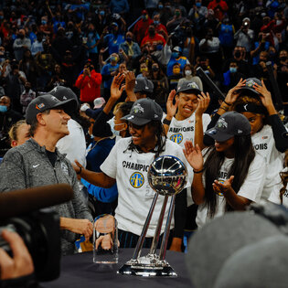
The Chicago Sky this week won the championship in W.N.B.A. They were led by Candace Parker, an all-star who grew up near Chicago and joined her hometown team this season after 13 years in Los Angeles.

Slide 10
The photo below is from “Dune”, a film adapted from a classic sci-fi novel, that came to theaters on Friday. It is based on the 1965 novel by Frank Herbert.

Slide 11
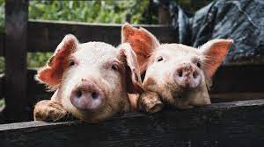
A kidney grown in a genetically altered animal was attached to a human patient in a New York hospital and found to work normally. The kidney was grown in a pig. Surgeons at NYU Langone Health attached the kidney to a brain-dead patient who was being kept alive on a ventilator, and discovered that the organ functioned normally.

Slide 12
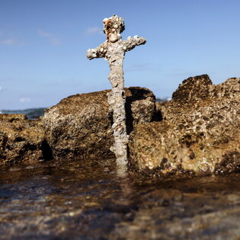
A diver discovered a sword on the sea floor off the coast of Israel. Archaeologists determined that it is about 900 years old and most likely belonged to a knight in the Third Crusade who fell into the sea or lost the weapon in battle.

Slide 13
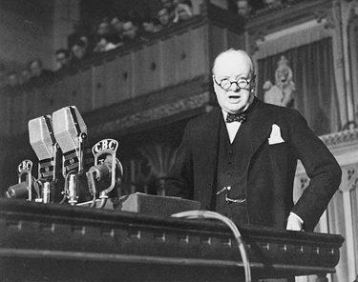
Winston Churchill, “We Shall Fight on the Beaches”
June 4, 1940; House of Commons, London
Winston Churchill, one of the greatest orators of the 20th century, was interestingly enough, born with a speech impediment which he worked on until it no longer hindered him. One would never guess this from hearing Churchill's strong and reassuring voice, a voice that would buoy up Britain during some of her darkest hours.
During the Battle of France, Allied Forces became cut off from troops south of the German penetration and perilously trapped at the Dunkirk bridgehead. On May 26, a wholesale evacuation of these troops, dubbed "Operation Dynamo," began. The evacuation was an amazing effort – From military destroyers to small fishing boats, they were used to ferry 338,000 French and British troops to safety, far more than anyone had thought possible. On June 4, Churchill spoke before the House of Commons, giving a report which celebrated the "miraculous deliverance" at Dunkirk, while also seeking to temper a too rosy of view of what was on the whole a "colossal military disaster."

Slide 14
“I have, myself, full confidence that if all do their duty, if nothing is neglected, and if the best arrangements are made, as they are being made, we shall prove ourselves once again able to defend our Island home, to ride out the storm of war, and to outlive the menace of tyranny, if necessary for years, if necessary alone. At any rate, that is what we are going to try to do. That is the resolve of His Majesty's Government-every man of them. That is the will of Parliament and the nation. The British Empire and the French Republic, linked together in their cause and in their need, will defend to the death their native soil, aiding each other like good comrades to the utmost of their strength.
Even though large tracts of Europe and many old and famous States have fallen or may fall into the grip of the Gestapo and all the odious apparatus of Nazi rule, we shall not flag or fail. We shall go on to the end, we shall fight in France, we shall fight on the seas and oceans, we shall fight with growing confidence and growing strength in the air, we shall defend our Island, whatever the cost may be, we shall fight on the beaches, we shall fight on the landing grounds, we shall fight in the fields and in the streets, we shall fight in the hills; we shall never surrender, and even if, which I do not for a moment believe, this Island or a large part of it were subjugated and starving, then our Empire beyond the seas, armed and guarded by the British Fleet, would carry on the struggle, until, in God's good time, the New World, with all its power and might, steps forth to the rescue and the liberation of the old.”

Slide 15
Source: CNN Weekly News

