Slide 1
Advanced English Class
October 16, 2021
* Compiled by Sophie Zhang
* The materials included here are for English class practice only. Please do not distribute.

Slide 2
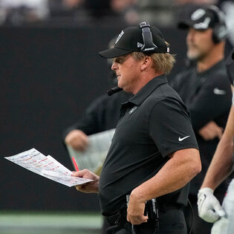
Jon Gruden, a former football coach, resigned this week after emails surfaced in which he made homophobic, racist and misogynistic remarks. He departed from the N.F.L. franchise Las Vegas Raiders.

Slide 3
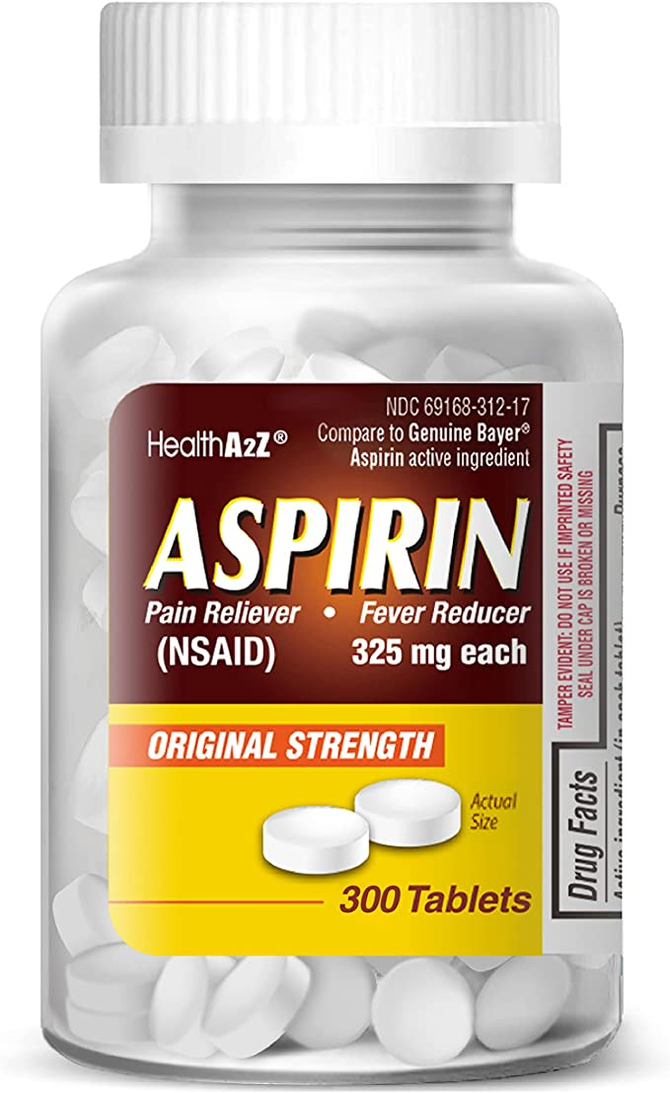
A U.S. panel said this week that doctors should no longer routinely prescribe Aspirin as a preventive measure. A U.S. panel of experts said that adults at high risk for cardiovascular disease might face serious side effects if they started a daily regimen of low-dose aspirin.

Slide 4
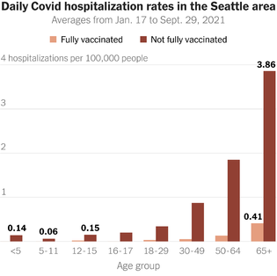
According to data from England and the Seattle area, unvaccinated people 65 or older are at higher risk of being hospitalized with Covid symptoms. A vaccinated 65-year-old is more at risk of serious Covid illness than an unvaccinated young child, according to data from the Seattle area and from England.

Slide 5
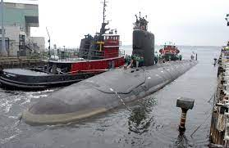
The F.B.I. arrested a Maryland couple accused of trying to sell U.S. secrets about nuclear powered submarine technology to a foreign country. They appeared in court on Tuesday and could face life in prison.

Slide 6
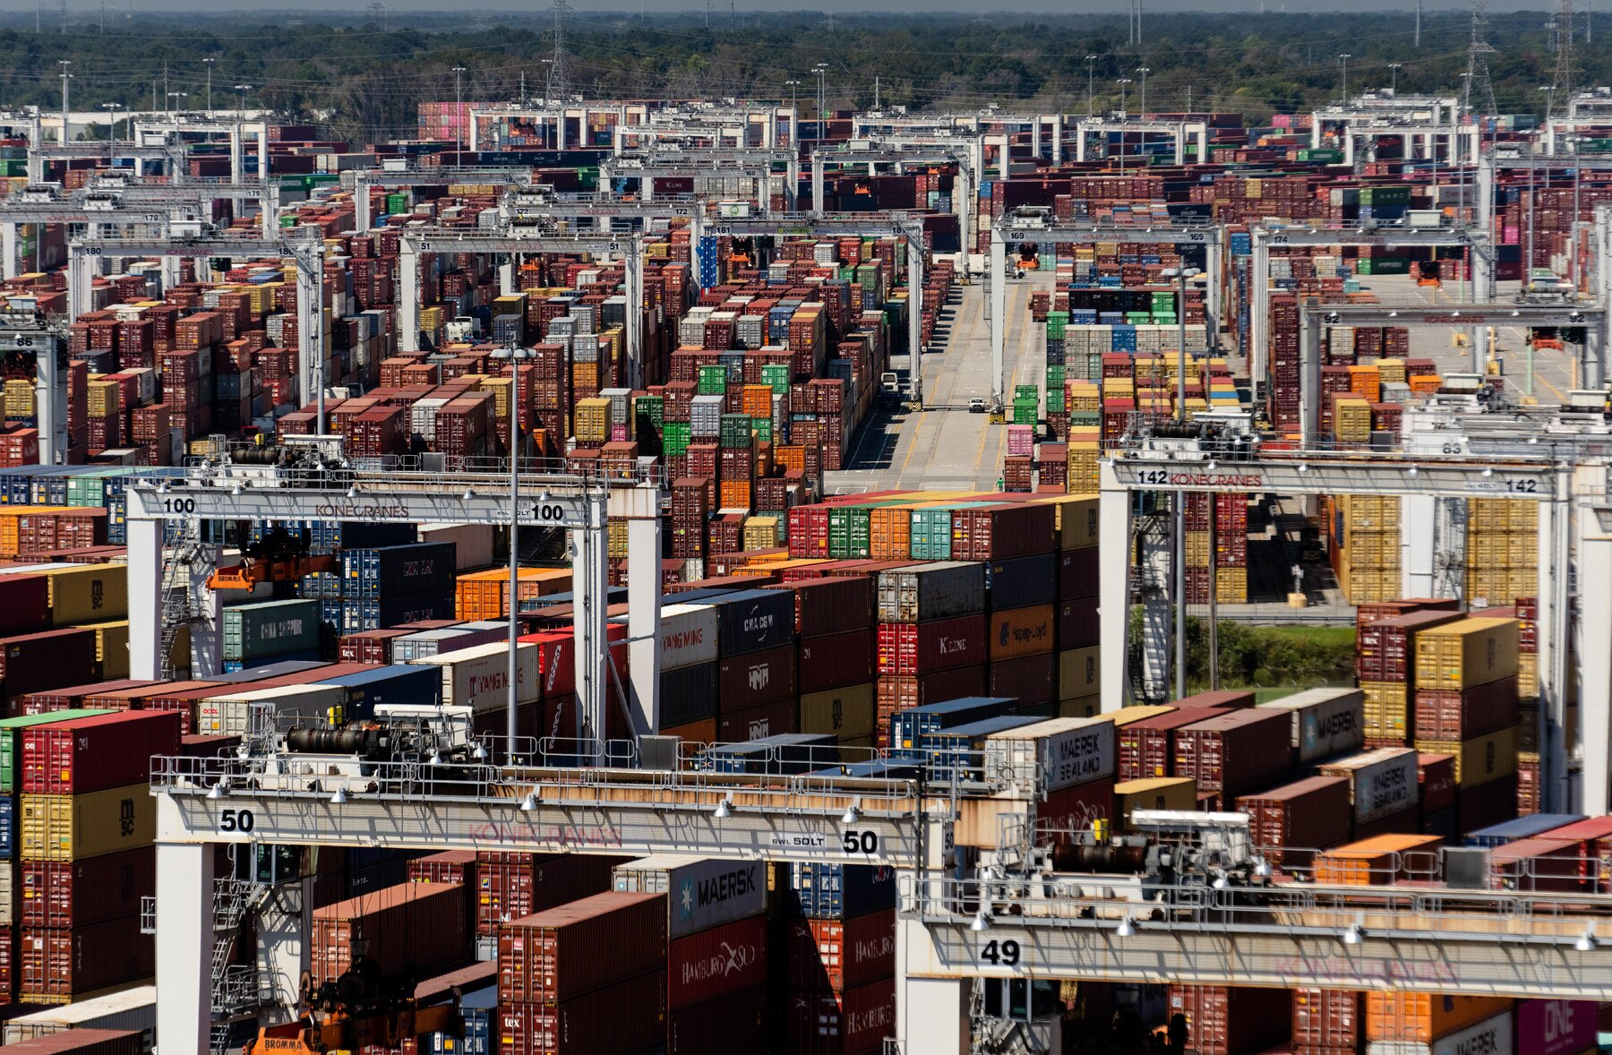
Nearly 80,000 shipping containers are jamming the port of Savannah in Georgia as the supply chain crisis continues. The Port of Savannah is the third-largest container port in the United States, and it is running out of room.

Slide 7
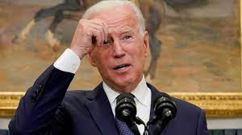
Congressional Democrats are considering paring back — or dropping entirely — from President Biden’s spending bill: funding for home health care, paid family leave, subsidies for child care, universal pre-K, etc.. To win votes from centrists in their party, Democrats expect to have to drastically shrink the package’s proposed $3.5 trillion in new spending. That could reduce the funding available for many of the bill’s health care, family and other policies.

Slide 8
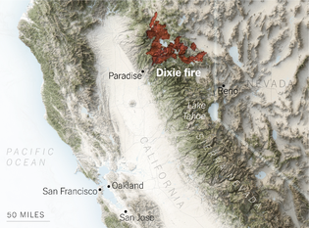
The Dixie fire in California has burned more than 960,000 acres over the past three months. This is similar in size to Rhode Island.

Slide 9
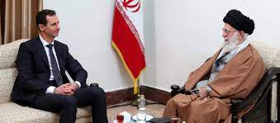
After years of isolation, nations are restoring ties with the Middle Eastern country of Syria. Despite a civil war and a dismantled economy, Arab countries are gradually restoring ties with Syria and its leader, Bashar al-Assad.

Slide 10
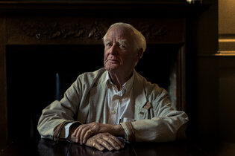
“Silverview” was released this week, the 26th and final novel from John Le Carre who died last year. The book features a young bookstore owner in an English seaside town, caught up in an investigation involving two cunning spymasters.

Slide 11
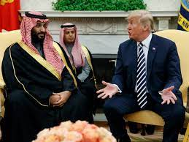
Donald Trump was gifted three robes made with white tiger and cheetah fur from the Saudi royal family in 2017. This week it was reveal that the furs were fake. They were one example of how gift exchanges between the U.S. and other countries devolved into sometimes risible shambles during the Trump administration.

Slide 12
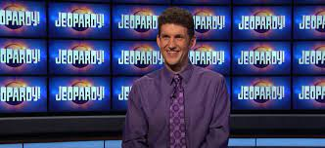
The second-longest winning streak in “Jeopardy!” history ended after 38 wins. The contestant was Matt Amodio, a Yale graduate student in Computer Science. His 39th appearance and first loss aired this week. He earned $1.5 million in prize money, the third most regular-season winnings in the show’s history

Slide 13
Quotes on Friendship
Sometimes, being with your best friend, is all the therapy you need. -Unknown
Keep the ones that heard you when you never said a word. -Unknown
I would rather walk with a friend in the dark, than alone in the light. -Helen Keller
A true friend accepts who you are, but also helps you become who you should be. -Unknown
A friend knows the song in my heart and sings it to me when my memory fails. -Donna Roberts
Sometimes you meet a person and you just click—you’re comfortable with them, like you’ve known them your whole life, and you don’t have to pretend to be anyone or anything. -Unknown
Because of you, I laugh a little harder, cry a little less, and smile a lot more. –Unknow
That’s when I realized what a true friend was. Someone who would always love you—the imperfect you, the confused you, the wrong you—because that is what people are supposed to do. -Unknown
What draws people to be friends is that they see the same truth. They share it. -C.S. Lewis
True friends are like diamonds—bright, beautiful, valuable, and always in style. -Nicole Richie
A good friend knows all your stories. A best friend helped you create them. -Unknown
A friend is someone who makes it easy to believe in yourself. -Heidi Wills
There’s nothing better than a friend, unless it is a friend with chocolate. -Unknown
Rare as is true love, true friendship is rarer. -Jean de La Fontaine
Some people arrive and make such a beautiful impact on your life, you can barely remember what life was like without them. -Anna Taylor

Slide 14
Source: CNN Weekly News https://mp.weixin.qq.com/s/hd_61QsptiSyKL020iHh4g

