Slide 1
New Zealand went into full lockdown after the discovery of a single, locally transmitted case of Covid-19 in the country. The case, discovered in a 58-year-old unvaccinated man from Aukland, was New Zealand’s first locally transmitted case of Covid-19 since February. More positive cases have since arisen.

Slide 2
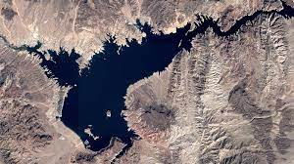
Lake Mead, located in Arizona and Nevada, is the largest reservoir in the US by volume. It is dealing with historic lows as the Colorado River, its main tributary, is experiencing a federally declared water shortage for the first time ever due to climate change change-induced drought.

Slide 3
T-Mobile, a telecommunications company, confirmed that it had been breached by a cyber-attack, compromising the personal information of tens of millions of current, past and prospective customers, according to the company.

Slide 4
The Taliban has taken swift control of Afghanistan, including the capital city of Kabul, following the withdrawal of US troops. The last time the Islamist group held control of the country was in 1996 until 2001, when the Taliban was forced out of power by the US-led invasion.

Slide 5
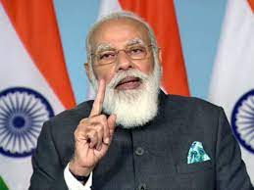
Prime Minister of India has announced a plan to spend over 100-trillion rupee ($1 trillion dollars) on infrastructure and the creation of hundreds of thousands of jobs. He is calling the plan “Gati Shakti,” which means momentum.

Slide 6
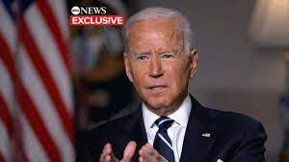
With the sudden takeover by the Taliban, the US is scrambling to bring Americans, respective allies, and Afghan partners safely out of Afghanistan. According to President Joe Biden, we should expect for all US citizens in Afghanistan to be evacuated by August 31.

Slide 7
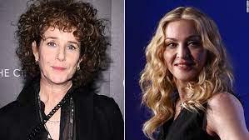
Actress Debra Winger revealed that she dropped out of an iconic 1992 film because Madonna was added to the cast. Saying that the addition turned the production into “an Elvis film,” Winger removed herself from the cast of the classic film “A League of Their Own,” and was ultimately replaced by Geena Davis.

Slide 8
After NASA initially pledged to offer multiple contracts to spur the development of at least two lunar landers, Blue Origin – owned by multi billionaire Jeff Bezos – filed a federal lawsuit over the agency’s exclusive contract of the HLS project to SpaceX for $2.9 billion in April.

Slide 9
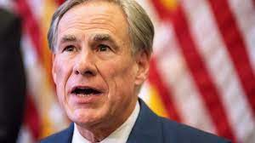
Greg Abbott, Republican governor of Texas, tested positive for coronavirus this week. His positive test result follows his attendance of an indoor “Republican Club” event. Abbott has opposed mask mandates, and issued of an executive order banning school districts from requiring masks and other Covid-19 restrictions.

