Slide 1
Advanced English Class
August 14, 2021
* Compiled by Sophie Zhang
* The materials included here are for English class practice only. Please do not distribute.

Slide 2
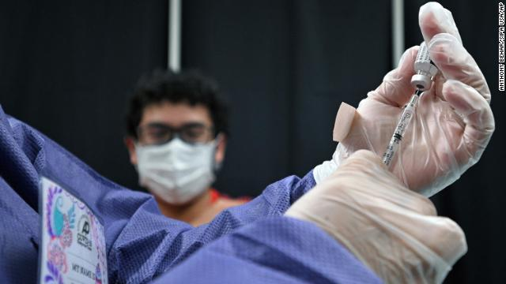
“If you’re unvaccinated, unfortunately, you will not be able to participate in many things.” New York City Mayor said these words, referencing the city’s upcoming vaccine requirements for restaurants, fitness centers and indoor entertainment venues. The move falls in line with an ever-growing list of private companies mandating vaccines.

Slide 3
Mexico is suing 11 gun manufacturers for their part in the drug trade and other crime. The 11 manufacturers include Smith & Wesson, Colt and Glock, over firearms that flow from the US into criminal hands in Mexico.

Slide 4
Florida, according to the Florida Hospital Association, has seen the dramatic increase in hospitalizations. The FHA predicts that 60% of hospitals are likely to face a “critical staffing shortage” in the coming days.

Slide 5
A slice of the couple’s wedding cake from Princess Diana and Prince Charles’ 1981 wedding went for auction on August 11. An item expected to go for at least 200 pounds — or nearly $278.

Slide 6
According to the statement, Messi – one of the highest paid athletes in the history of sport — will be leaving Barcelona, a club he joined in 2004. It’s where he won 10 La Liga titles and four Champions Leagues.

Slide 7
Fueled by a surge in credit card spending and home purchases, US households held $14.96 trillion dollars in debt at the end of June – the largest amount of bills on record.

Slide 8
Contrary to what’s typically considered popular, demand for minivans is on the rise. They’re selling at an average 8% above sticker price, all as families look for more practical options. In contrast, trucks, cars and SUVs have been selling at sticker price.

Slide 9
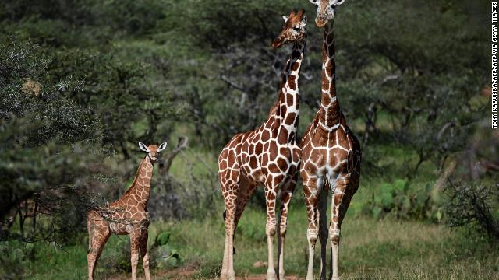
Long misunderstood, the study found giraffes to be as socially complex as elephants, primates and even orcas. “It is baffling to me how such a charismatic and well-known species as the giraffe could have been so understudied until recently,” said Zoe Muller, biologist and study author.

Slide 10
Source: CNN Weekly News

