Slide 1
Advanced English Class
July 31, 2021
* Compiled by Sophie Zhang
* The materials included here are for English class practice only. Please do not distribute.

Slide 2
Surfing, karate, skateboarding and sport climbing are appearing as Olympic sports for the first time, while baseball and softball are back for their first Games since 2008. Women’s boxing debuted at the 2012 Games in London, and chess has never been an Olympic sport.

Slide 3
Sunisa Lee, who is 18 and from St. Paul, Minnesota, defeated her Brazilain competitor by less than two-tenths of a point to secure the gold medal. She is the fifth American in a row to win the women’s all-around title and the first Asian American to win the title.

Slide 4
Japan beat the U.S. for softball, winning gold, on Tuesday in Tokyo. The same thing happened 13 years ago in Beijing, the last time softball was an Olympic sport.

Slide 5
Reversing course this week, the C.D.C. said that vaccinated people should return to wearing masks in public indoor spaces in parts of the country where the virus is surging. The announcement of the new guidelines was both vague and technical, making it hard for many nonexperts to understand.

Slide 6
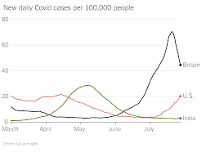
India’s cases are down by more than 90 percent since reaching a peak in early May. There’s no explanation for the drop: Only 7 percent of India’s population is fully vaccinated.

Slide 7
Tunisia’s democracy — the only one remaining from the Arab Spring movement — was on the brink of collapse this week. Tunisian president sought to seize power from the rest of the government, suspending parliament and firing the prime minister, in which his political opponents denounced as a coup (pronounced Koo) .

Slide 8
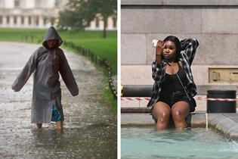
Fires, floods and heat waves have ravaged areas from the Pacific Northwest to central China. Rainfall wreaked havoc across London, flooding train stations, stranding motorists and forcing at least two hospitals to redirect patients from their emergency rooms. The rain came at the tail end of a heat wave.

Slide 9
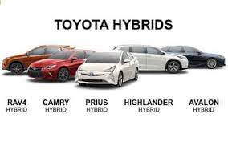
Toyota has based much of its strategy around the sale of hybrid vehicles and has quietly become the industry’s strongest voice opposing an all-out transition to electric vehicles. Toyota has staked its near-term future on gas-electric hybrids, like the Prius, and its long-term future on hydrogen fuel cells. “Toyota has gone from a leading position to an industry laggard,” an expert on climate lobbying said.

Slide 10
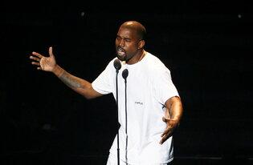
Kanye West is residing in Atlanta’s Mercedes-Benz Stadium until he completes his 10th studio album, named for his late mother. He premiered his new album “Donda” to a crowd at the stadium last week. But the album was apparently incomplete, and he set up a studio inside the venue to finish it, CNN reports.

Slide 11
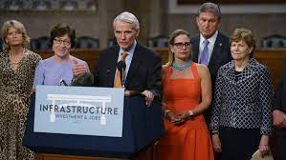
Seventeen G.O.P. senators voted to begin debate on a plan to fund roads, bridges, broadband and more after a bipartisan group reached a compromise agreement with the White House. The bill could pass within days.

Slide 12
An orphaned grizzly bear named Arthur along with his siblings was transported back to the wild after spending about eight months at a wildlife sanctuary in British Columbia. This is part of a Canadian program to track how orphaned bears manage in the wild.

Slide 13
Harvard Research Reveals 20 Happiness Habits – to continue from last week
6. Do what you love. 做你想做的事情。
Since we spend over one-third of our adult life working, loving what we do has a huge impact on our overall happiness. If this is not possible at the moment, then try to find enjoyment and meaning in your current work, or cultivate a hobby that involves doing something you love.
由于我们成年后三分之一的时间都在工作，热爱我们所做的事情对我们的整体幸福感有着巨大的影响。如果现在不能做你想做的事情，那就试着在你当前的工作中找到乐趣和意义，或者培养一个你喜爱的兴趣。

Slide 14
7. Live in the present. 活在当下。
When you feel depressed, you’re living in the past. When you feel worried or anxious, you’re living in the future. But when you feel content, happy and peaceful, you’re living in the present.
当你感到沮丧时，那是因为你活在过去。 当您感到担心或焦虑时，那是因为
你生活在未来。 但当你感到满足、快乐和平和时，你才是活在当下。
8. Laugh often. 要经常笑。
Laughter is the most powerful anecdote to anger or depression. Research has shown that the simple act of curving the corners of your mouth can increase your feeling of happiness. So don’t take life too seriously. Try to find humor and laughter in life’s everyday struggles.
笑是对抗愤怒或沮丧最有力的的东西。研究表明，弯曲嘴角的简单动作可以增加你的幸福感。 所以不要把生活看得太重，要学会在每日的奋斗中找到幽默感和笑声。

Slide 15
9. Practice forgiveness. 学习原谅。
Resentment and anger are forms of self-punishment. When you forgive, you’re actually practicing kindness to yourself. And most importantly, learn to forgive yourself. Everyone makes mistakes. It’s through our mistakes that we learn and grow to become a bigger and better person.
怨恨和愤怒是自我惩罚的形式。当你原谅时，你实际上是在练习对自己
施以善意。最重要的是，学会原谅自己。每个人都会犯错。 只有通过我
们的错误，我们才慢慢学会如何成为一个更强大，更好的人。
10. Say thanks often. 经常说谢谢。
Always be appreciative of the blessings in your life. And it’s equally important to express your appreciation to those who’ve made your life better in some way, big or small.
对生活中的祝福要学会欣赏。同样重要的是向那些以某种方式让你的生
活变得更好的人表达你的感激之情，无论或大或小。

Slide 16
To be continued next week… Source: 1. New York Times Weekly News 2.https://mp.weixin.qq.com/s/hd_61QsptiSyKL020iHh4g

