Slide 1
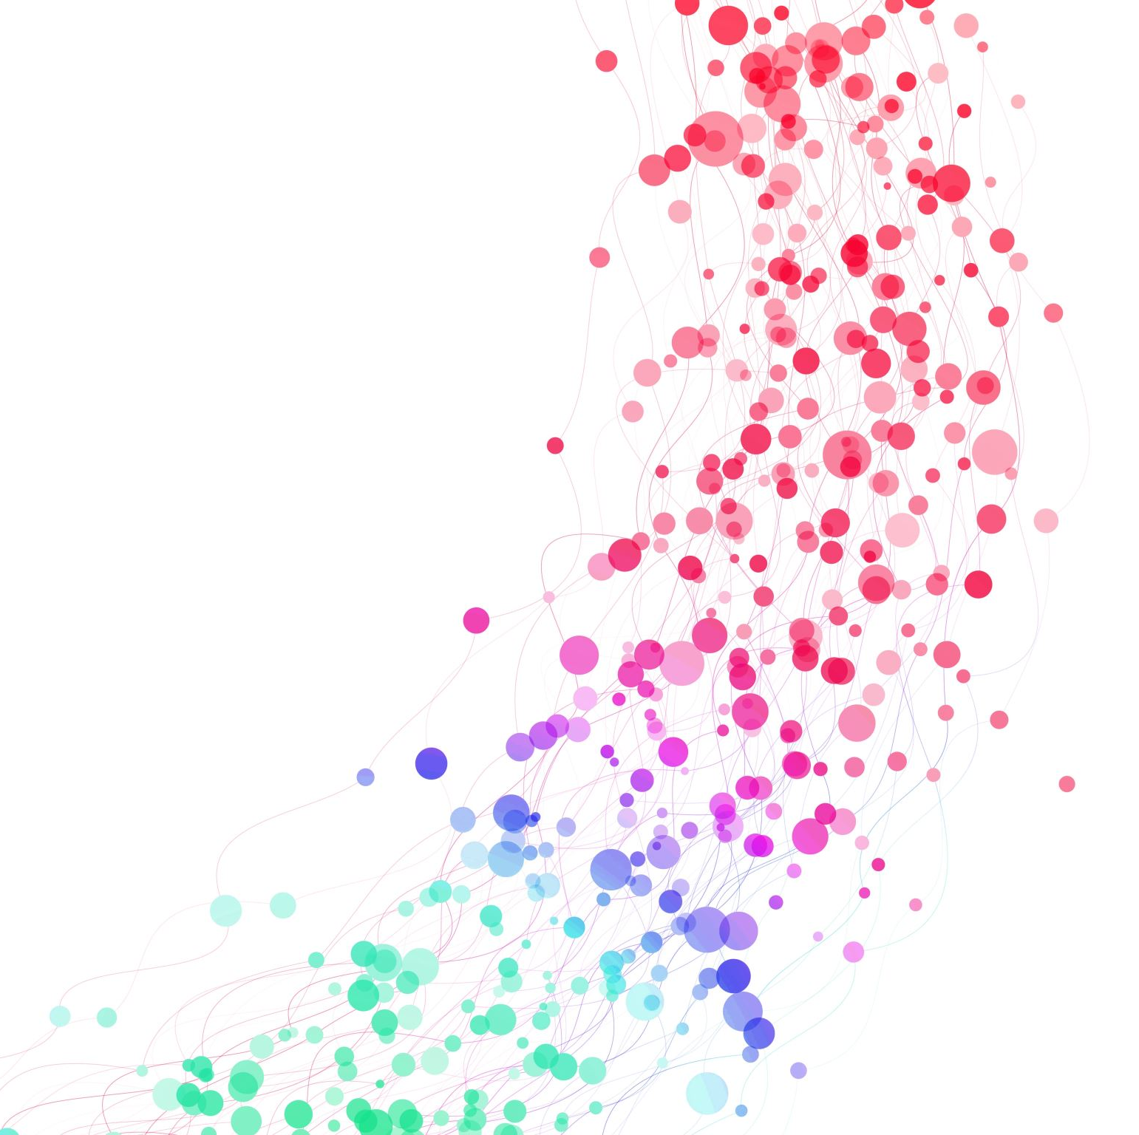
Bamboo School 青竹学苑
Advanced English Class
July 3, 2021

Slide 2
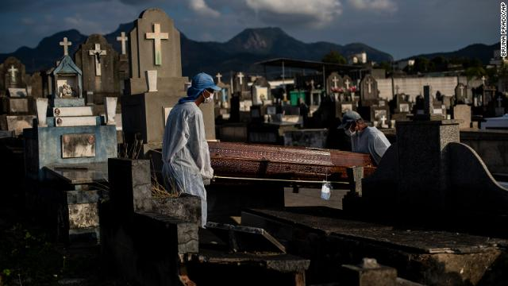
Brazil just crossed a tragic threshold in coronavirus deaths, and maintains the second-highest death count in the world due to Covid-19. Brazil has lost more than 500,000 people to the virus, second only to the United States which has recorded more than 600,000 total deaths.

Slide 3
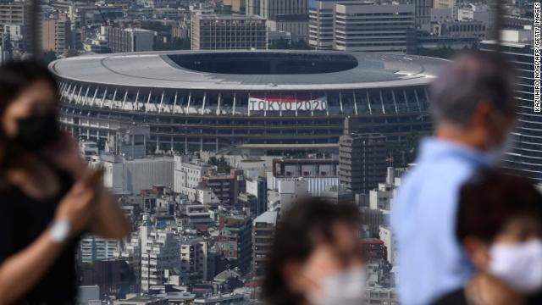
Tokyo 2020 announced that this summer’s Olympic games will, in fact, go on. The Olympic games will go on with a 50% capacity cap put on all venues, with a maximum of 10,000 spectators allowed.

Slide 4
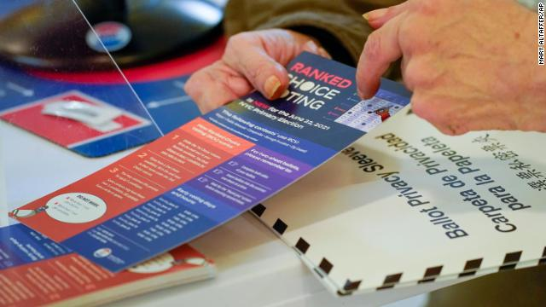
New York City residents voted in the city’s primaries. This election used a special type of voting system that involves choosing more than one candidate for each role. New York City employed ranked-choice voting, a system where voters rank their top five candidates in order of preference. It’s the United States’ largest jurisdiction to give the voting system a try.

Slide 5
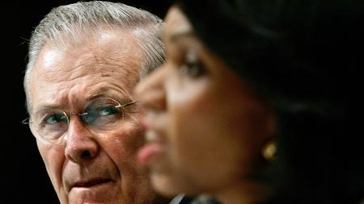
Donald Rumsfeld, the architect of the Iraq war, died this week. He served as Secretary of Defense under two US presidents – under President Ford from 1975 to 1977 and then under President George W. Bush from 2001 to 2006.

Slide 6
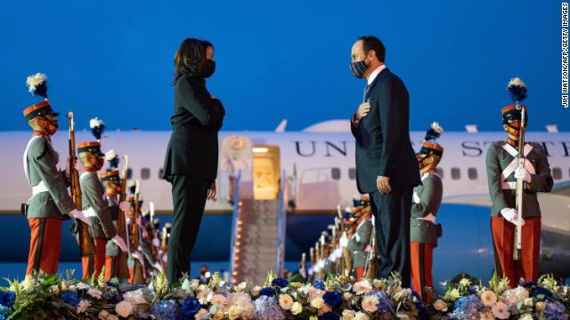
In her first foreign trip in office, Vice President Kamala Harris traveled to Mexico and Guatemla as part of a diplomatic effort to stem the flow of migration at the southern border.

Slide 7
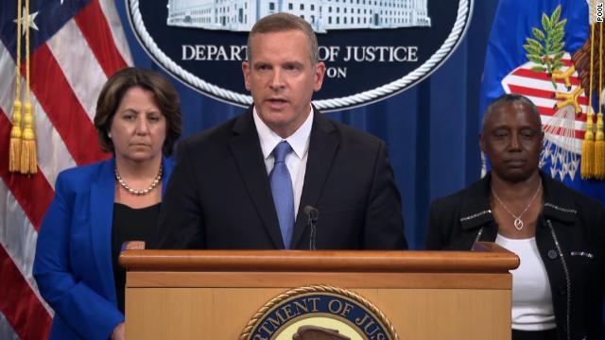
In a win against cybercriminals, the Justice Department announced that it recovered nearly $2.3 million in Bitcoin paid out during a ransomware attack targeting Colonial Pipeline. The recovered Bitcoin was part of a ransom paid to hackers whose ransomware attack against Colonial Pipeline led to the shutdown of the fuel pipeline, a critical energy artery servicing the Eastern United States.

Slide 8
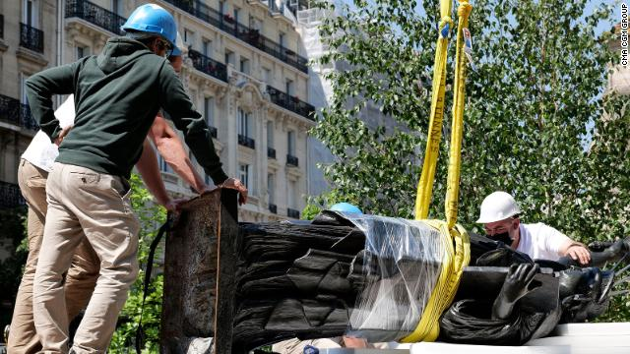
France is sending a second, much smaller version of the Statue of Liberty to the United States, just in time to be displayed for July 4th celebrations. The “little sister” – just shy of 10 feet tall and weighing some 992 pounds – will be erected from July 1 to July 5 on Ellis Island. France also gave the US the original statue, which was dedicated in 1886.

Slide 9
Classic Quotes
The greatest glory in living lies not in never falling, but in rising every time we fall. -Nelson Mandela
The way to get started is to quit talking and begin doing. -Walt Disney
Your time is limited, so don't waste it living someone else's life. Don't be trapped by dogma – which is living with the results of other people's thinking. -Steve Jobs
If life were predictable it would cease to be life, and be without flavor. -Eleanor Roosevelt

Slide 10
If you look at what you have in life, you'll always have more. If you look at what you don't have in life, you'll never have enough. -Oprah Winfrey
If you set your goals ridiculously high and it's a failure, you will fail above everyone else's success. -James Cameron
Life is what happens when you're busy making other plans. -John Lennon
Spread love everywhere you go. Let no one ever come to you without leaving happier. -Mother Teresa
When you reach the end of your rope, tie a knot in it and hang on. -Franklin D. Roosevelt

Slide 11
Always remember that you are absolutely unique. Just like everyone else. -Margaret Mead
Don't judge each day by the harvest you reap but by the seeds that you plant. -Robert Louis Stevenson
The future belongs to those who believe in the beauty of their dreams. -Eleanor Roosevelt

