Slide 1
Advanced English Class
July 24, 2021
* Compiled by Sophie Zhang
* The materials included here are for English class practice only. Please do not distribute.

Slide 2
Exacerbated by the effects of climate change, the Bootleg Fire has ravaged hundreds of thousands of acres. The fire is located in southern Oregon and has burned nearly 400,000 acres, making it the third largest wildfire in the state’s history.

Slide 3
“Space Jam: A New Legacy,” a sequel to the iconic “Space Jam” movie, is hitting theaters. NBA star LeBron James stars as the main character this time around in “Space Jam: A New Legacy” surrounded by a classic lineup of cartoon friends. Michael Jordan starred in the original 1996 film.

Slide 4
The Dow plunged nearly 725 points, the largest drop since late October. Investors reacted to increases in Covid-19 cases and the potential ramifications of the more-transmissible Delta variant, all culminating in fears of a pandemic resurgence threatening economic recovery.

Slide 5
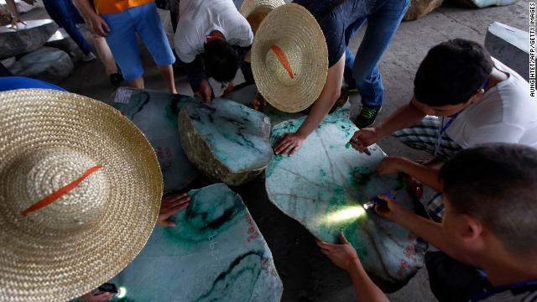
Myanmar’s military junta still holds widespread power over the country following a February coup. Now, a new report reveals they also have a commanding hold on the jade industry. Myanmar produces about 70% of the world’s jade, worth billions of dollars, and the junta has such a strong hold that experts say it would be nearly impossible to buy the gem there without enriching the country’s generals and their allies.

Slide 6
The Biden administration has leveled blame against China for some of the latest wide-scale cyber breaches, including a recent attack against Microsoft’s email system. The US, along with some its closest foreign allies in Europe and Asia, released a coordinated statement accusing China’s Ministry of State Security as being behind some of the latest cyberattacks.

Slide 7
According to an article published in JAMA Internal Medicine, contrary to popular belief, drinking coffee doesn’t actually cause heart palpitations.

Slide 8
New CDC research found that US life-expectancy decreased in 2020 from 78.8 years in 2019. The average life expectancy dropped by 1.5 years last year, going from 78.8 years in 2019 to 77.3 years in 2020 – all primarily due to an increase in death caused by the Covid-19 pandemic.

Slide 9
A group of states’ attorneys general proposed a settlement of $26 billion that would resolve thousands of claims against pharmaceutical distributors for their role in national opioid crisis.

Slide 10
Crocs sued Walmart and other entities over trademark infringement, claiming the companies are copying their iconic products.

Slide 11
Harvard Research Reveals 20 Happiness Habits
1. Be grateful. 学会感恩。
Slow down, look around you, and pay attention to the little details in your life – the delicate purple flower on the sidewalk, the beautiful sunset, the hot shower that washes away your long day, and the smile in your partner’s eyes…
放慢脚步，环顾四周，关注生活中的点点滴滴：人行道上娇嫩的紫色花朵、美丽的日落、洗去你一天疲惫的淋浴、伴侣眼中的微笑……

Slide 12
2. Choose your friends wisely. 明智地选择你的朋友。 According to Harvard, the most important external factors affecting individual happiness are human relationships. So if you want to be happy, choose to be around people who are optimistic, who appreciate you as you are, and who can make your life richer, bigger, more fun, and more meaningful.
哈佛认为，影响个人幸福感最重要的外部因素是人际关系。所以，如果你想快乐，就选择和那些乐观的人在一起，他们欣赏真实的你，他们能让你的生活更丰富、更有趣、更有
3. Cultivate compassion. 培养同情心。
When we try to step into other people’s shoes and understand a situation from another’s perspective, we’re more likely to handle the situation with compassion, objectivity and effectiveness. There will be less conflicts and more happiness.
当我们尝试换位思考并从他人的角度理解情况时，我们更有可能以同情心、客观性和有效性来处理问题。 生活中就会少一些冲突，多一些快乐。
意义。

Slide 13
4. Keep learning. 不断学习。
Learning keeps us young and dreams keep us alive. When we engage our brains and put them toward productive uses, we’re less likely to dwell on unhappy thoughts and much more likely to feel happy and fulfilled.
学习让我们保持年轻，梦想让我们充满活力。当我们调动大脑，进行运作的时候，我们就不太可能沉迷于不愉快的想法，而更有可能感到快乐和满足。
5. Become a problem solver. 成为问题的解决者。
Happy people are problem solvers. When they encounter a challenge in life, they don’t beat themselves up and fall into a depressive state. Instead, they face up to the challenge and channel their energies toward finding creative a solution. By becoming a problem solver, you’ll build up your self-confidence and your ability to accomplish whatever it is you set your mind to – and whatever challenges life throws your way.
快乐的人是解决问题的人。 当他们遇到生活中的挑战时，他们不会自暴自弃，陷入抑郁状态。 相反，他们直面挑战，调动全身力量寻找解决办法。通过成为一个问题解决者，你将建立自信，并有能力完成定下的目标——无论生活给您带来什么样的挑战。

Slide 14
To be continued next week… Source: 1. CNN Weekly News 2.https://mp.weixin.qq.com/s/hd_61QsptiSyKL020iHh4g

