Slide 1
Green Bamboo School 青竹学苑
Advanced English Class
July 17, 2021
* The materials included here are for English class practice only. Please do not distribute.

Slide 2
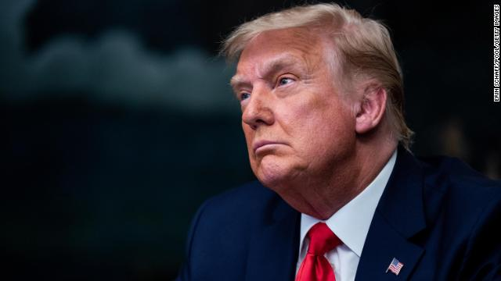
A grand jury in Manhattan has leveled criminal charges against The Trump Organization, his business group. Charges against the Trump Organization, and one of its top executives, are related to alleged tax crimes tied to an inquiry into employee perks such as rent-free homes, car leases and bonuses.

Slide 3
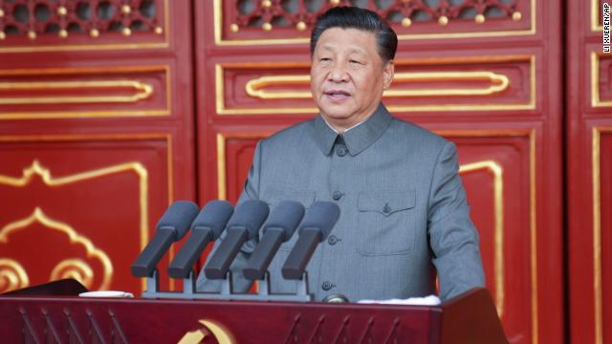
China recently commemorated an important anniversary of the birth of the Chinese Communist Party. Chinese President Xi Jinping was at the forefront of nationwide celebrations observing the 100th anniversary of the Chinese Communist Party.

Slide 4
U.S. News & World Report has released updated rankings of the healthiest communities in the US. Los Alamos County, New Mexico, has been ranked the healthiest US community for the second year in a row.

Slide 5
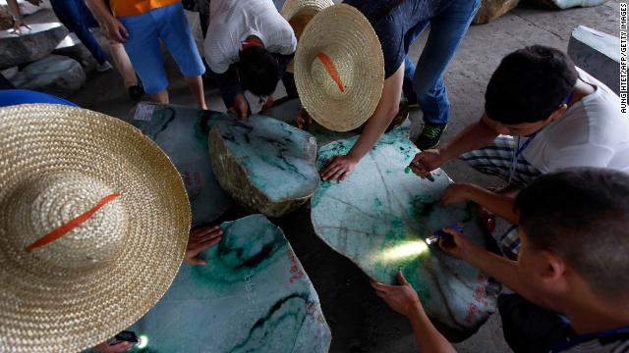
Myanmar’s military junta still holds widespread power over the country following a February coup. Now, a new report reveals they also have a commanding hold on the jade industry. Myanmar produces about 70% of the world’s jade, worth billions of dollars, and the junta has such a strong hold that experts say it would be nearly impossible to buy the gem there without enriching the country’s generals and their allies.

Slide 6
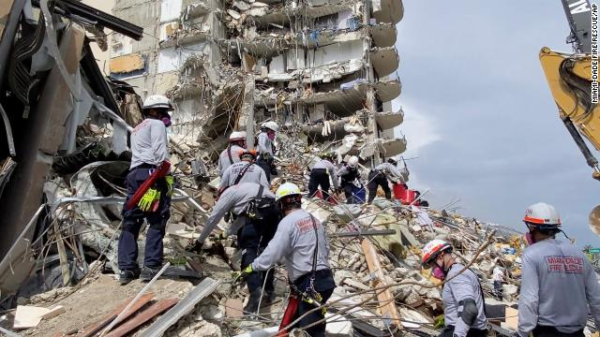
Rescuers are still sifting through debris at the site of the Miami-area condo collapse. So far, at least 20 people have been confirmed dead and more than 100 are still unaccounted for. Rescuers are having to contend with oncoming extreme weather and worries about fires and structural instability as they work their way through the 16 feet of debris from the collapse.

Slide 7
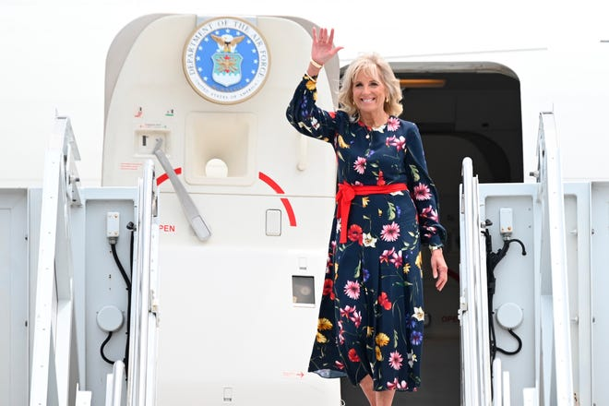
Jill Biden will travel to Tokyo to lead the U.S. delegation to the opening ceremony of the 2021 Summer Olympics. The trip will be Jill Biden's second journey abroad as first lady.

Slide 8
Context for John F. Kennedy Inauguration Address
Young, handsome, with a glamorous family in tow, John F. Kennedy embodied the fresh optimism that had marked the post-war decade.
Assuming office in the midst of the Cold War, JFK understood that his inaugural address would have to instill confidence at home and respect abroad. He believed that democracy thrives only when citizens contribute their talents to the common good, and that it is up to leaders to inspire citizens to acts of sacrifice.
On January 20, 1961, Kennedy took the oath of office as the 35th President of the United States. The youngest president in United States history, he was the first man born in the 20th century to hold that office. Listening to his inaugural address, the nation felt that a new era and a "new frontier" were being ushered in.

Slide 9
John F. Kennedy Inauguration Address
January 20, 1961; Washington, D.C.
Excerpt from the speech:
“Can we forge against these enemies a grand and global alliance, North and South, East and West that can assure a more fruitful life for all mankind? Will you join in that historic effort?
In the long history of the world, only a few generations have been granted the role of defending freedom in its hour of maximum danger. I do not shrink from this responsibility -- I welcome it. I do not believe that any of us would exchange places with any other people or any other generation. The energy, the faith, the devotion which we bring to this endeavor will light our country and all who serve it -- and the glow from that fire can truly light the world.
And so, my fellow Americans: ask not what your country can do for you -- ask what you can do for your country.
My fellow citizens of the world: ask not what America will do for you, but what together we can do for the freedom of man.”

Slide 10
Illinois Has Become The First State To
Require The Teaching Of Asian American History
Illinois Governor J.B. Pritzker has signed legislation requiring that Asian American history be taught in public schools starting in the 2022-2023 school year. Illinois is the first state in the nation to hold such a requirement.
The Teaching Equitable Asian American History (TEAACH) Act comes at a time when growing numbers of Asian Americans have become the targets of hate crimes in the midst of the COVID-19 pandemic. Asian Americans are facing hate incidents at a higher rate than ever reported before, and the Democratic governor says teaching students about Asian American history will help combat false stereotypes.
The new curriculum will add a new unit for every public elementary school and high school to learn about Asian American history, and the story of Asian Americans in Illinois and the Midwest, specifically.
Required topics that will be covered in the new school year include the Asian Americans advancing civil rights and the contributions Asian Americans have made in government, the arts, sciences, economics and politics.
"Asian American history is American history. Yet we are often invisible. The TEAACH Act will ensure that the next generation of Asian American students won't need to attend law school to learn about their heritage," said State Representative Jennifer Gong-Gershowitz, who sponsored the legislation.
"Empathy comes from understanding. We cannot do better unless we know better. A lack of knowledge is the root cause of discrimination and the best weapon against ignorance is education," she said.

