Slide 1
Green Bamboo School 青竹学苑
Advanced English Class
July 10, 2021
* The materials included here are for English class practice only. Please do not distribute.

Slide 2
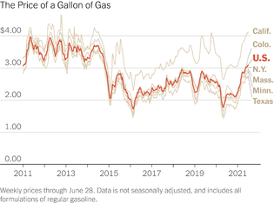
The national average price of a gallon of regular gas was closest to $3.15 this week according to AAA, up from $3.05 a month ago. The auto club said it expected gas price to increase another 10 to 20 cents through the end of August.

Slide 3
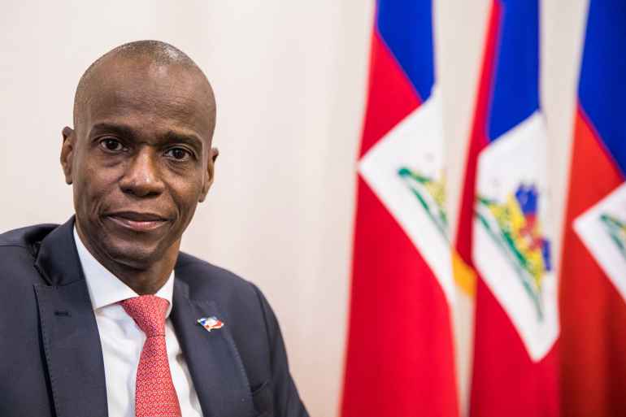
Haiti’s president, Jovenel Moïse, was assassinated this week; a gang leader called on citizens to raid businesses; the interim prime minister declared a form of martial law; and the country has been without a working parliament. But Haiti has yet to inoculate any of its population against Covid.

Slide 4
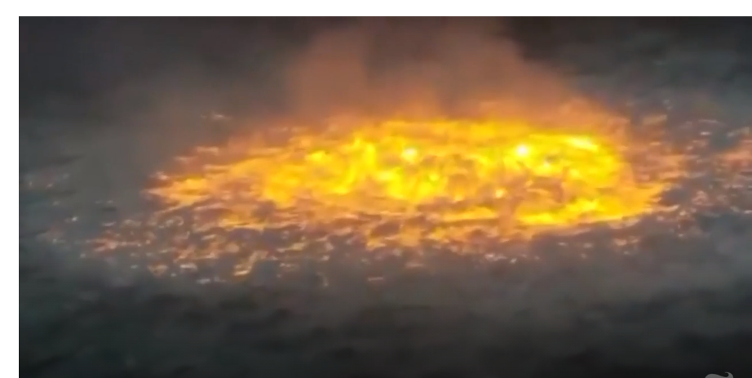
A leak from a gas pipe sparked an inferno that burned for more than five hours before it was extinguished. Pemex, Mexico’s state-owned oil monopoly, said that no one was injured and that it would investigate the cause of the leak.

Slide 5
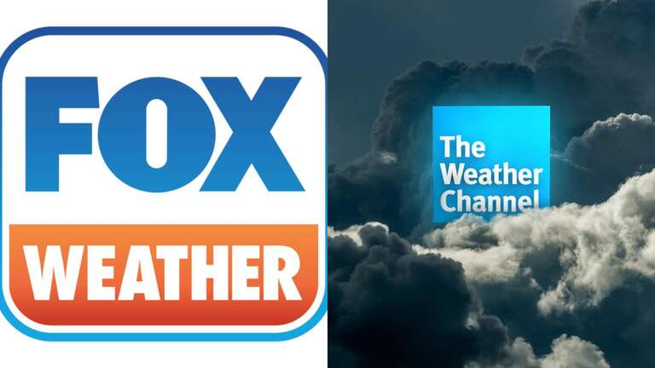
Rupert Murdoch is preparing to launch a new TV venture: Fox Weather. The company is aggressively poaching star meteorologists, hoping to become a powerful new player in a sphere long dominated by the Weather Channel.

Slide 6
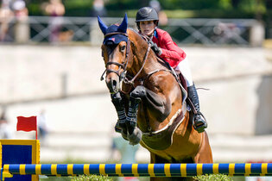
Jessica Springsteen, who is ranked 27th in the world in show jumping, is the daughter of Bruce Springsteen. Equestrian competition has drawn contenders from a rarefield subset, including Princess Anne, the daughter of Queen Elizabeth II; and Georgina Bloomberg, the daughter of Michael Bloomberg.

Slide 7
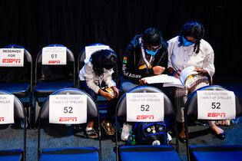
The finals of this year’s Scripps National Spelling Bee included the word gewgaw. Gewgaw is a noun, of unknown origin, that means “a trifle, something of no worth.” This year’s bee had new elements, including a word-meaning round, to try to avoid the eight-way tie that ended the 2019 contest.

Slide 8
Lebanon is currently suffering through a financial crisis that has resulted in frequent blackouts and a currency worth 90 percent less than it was in fall 2019. The World Bank ranks it among the world’s worst since the mid-1800s, in terms of its effect on living standards.

Slide 9
Background of the Gettysburg Address
During a three-day Civil War battle at Gettysburg in early July 1863, there were over 23,000 Union casualties (including more than 3,000 deaths) and 28,000 Confederate casualties (including at least 4,000 deaths). A portion of the battlefield was dedicated as a National Soldiers’ Cemetery for the thousands of soldiers who had died. Abraham Lincoln wrote and spoke the famous words known as the Gettysburg Address (below) at the ceremony on November 19, 1863. He was not the main speaker for the dedication. Edward Everett, a well-known orator, was the chief speaker and spoke for two hours. Lincoln’s speech consisted of 272 words, lasted 2 minutes, and became known as one of the greatest speeches ever made by an American president.

Slide 10
The Gettysburg Address
Gettysburg, Pennsylvania
November 19, 1863
Four score and seven years ago our fathers brought forth on this continent, a new nation, conceived in Liberty, and dedicated to the proposition that all men are created equal.
Now we are engaged in a great civil war, testing whether that nation, or any nation so conceived and so dedicated, can long endure. We are met on a great battlefield of that war. We have come to dedicate a portion of that field, as a final resting place for those who here gave their lives that that nation might live. It is altogether fitting and proper that we should do this.
But, in a larger sense, we cannot dedicate -- we cannot consecrate -- we cannot hallow -- this ground. The brave men, living and dead, who struggled here, have consecrated it, far above our poor power to add or detract. The world will little note, nor long remember what we say here, but it can never forget what they did here. It is for us the living, rather, to be dedicated here to the unfinished work which they who fought here have thus far so nobly advanced. It is rather for us to be here dedicated to the great task remaining before us -- that from these honored dead we take increased devotion to that cause for which they gave the last full measure of devotion -- that we here highly resolve that these dead shall not have died in vain -- that this nation, under God, shall have a new birth of freedom -- and that government of the people, by the people, for the people, shall not perish from the earth.

Slide 11
Quotes on Family
Family is not an important thing. It's everything. - Michael J. Fox
To us, family means putting your arms around each other and being there. - Barbara Bush
I believe the world is one big family, and we need to help each other. - Jet Li
In every conceivable manner, the family is link to our past, bridge to our future. - Alex Haley

