Slide 1
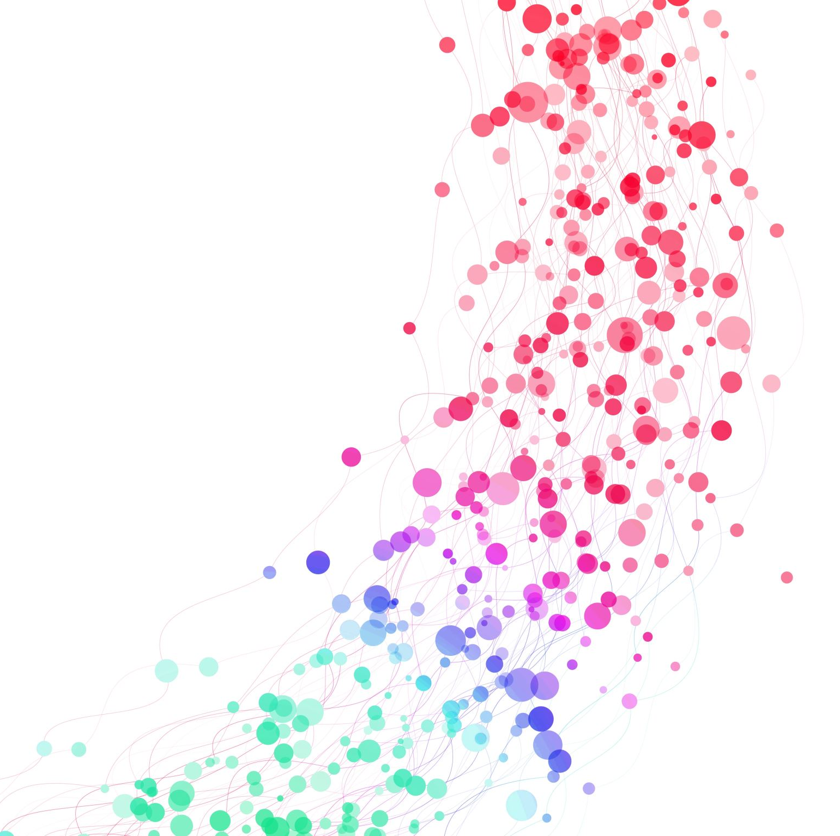
Bamboo English Advanced Class
June 26, 2021

Slide 2
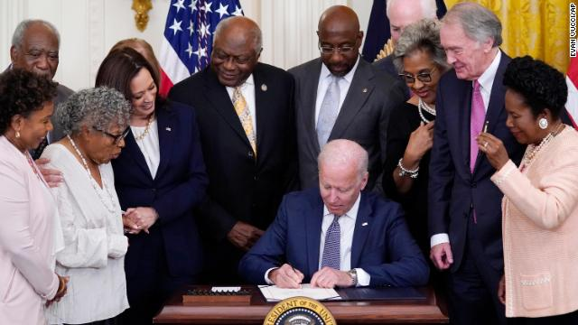
President Joe Biden signed legislation making June 19th – officially called
Juneteenth National Independence Day – a federal holiday, commemorating
June 19, 1865 when slaves in Texas were told of their emancipation.

Slide 3
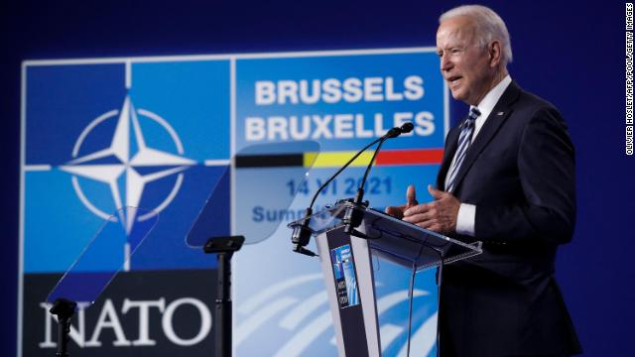
The 31st North Atlantic Treaty Organization (NATO) summit recently
took place, the first of President Joe Biden’s presidency.
In what city did the summit happen?
Brussels, Belgium

Slide 4
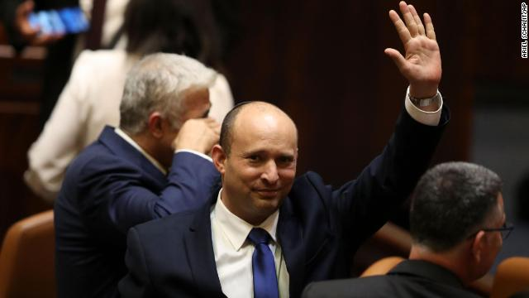
Naftali Bennett was sworn in as the new prime minister of Israel, putting an
end to Benjamin Netanyahu’s 12-year grip on power – the longest running in
Israeli history

Slide 5
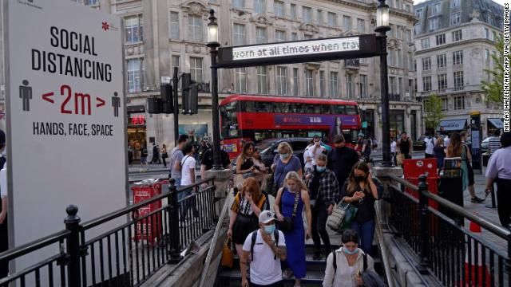
According to the CDC, the Delta variant has emerged as one of the most treatment-resistant and contagious coronavirus variants, rapidly spreading in the US. Luckily, early indications show that vaccines provide effective protection against the variant for fully vaccinated individuals.

Slide 6
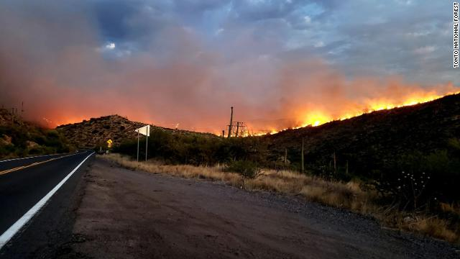
As the western portion of the United States experiences record heat and relentless drought, which state is dealing with the wrath of the Telegraph Fire, one of the largest in the region’s history.

Slide 7
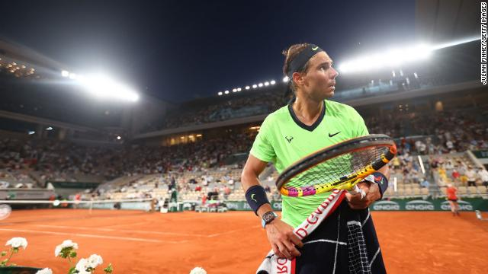
Which 20-time tennis grand slam champion announced that they’re pulling out of Wimbledon and the Tokyo Olympics, saying that the quick turnaround of competition “didn’t make it easier on my body to recuperate?”
Rafael Nadal

Slide 8
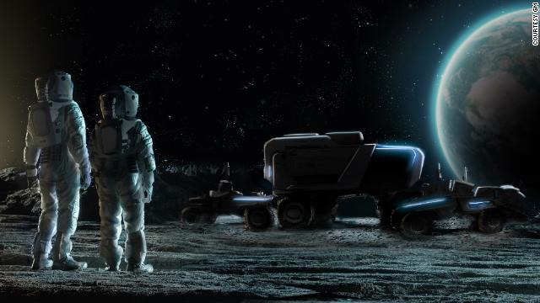
In the hopes of one day getting a contract from NASA, Lockheed Martin and GM have partnered to create the next generation of the Lunar Rover – all in anticipation of NASA’s latest ambitions to return to the moon.

Slide 9
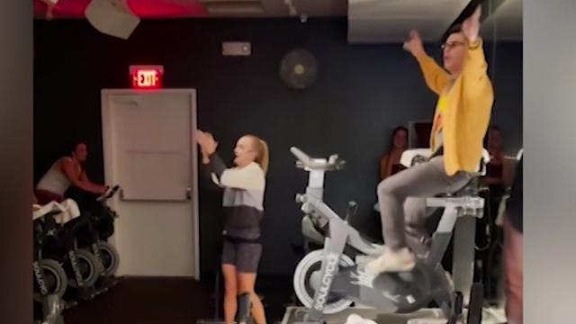
According to a post on his Instagram, Joe Jonas crashed a “Jonas Brothers vs. One Direction” spin class at a SoulCycle studio in Atlanta – the slick move made during apparent free time while on a business trip in the city.

Slide 10
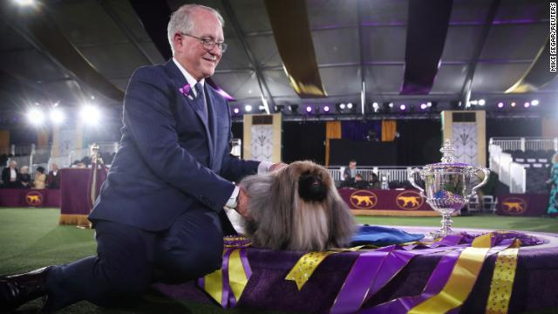
A Pekingese named Wasabi won the title of Best in Show. Because of the pandemic, the event took place in Lyndhurst Estate in Tarrytown, New York, the first time since 1877 the dog show wasn’t held in New York City’s Madison Square Garden.

Slide 11
I have a dream – Martin Luther King
I have a dream that one day on the red hills of Georgia, the sons of former slaves and the sons of former slave owners will be able to sit down together at the table of brotherhood.
I have a dream that one day even the state of Mississippi, a state sweltering with the heat of injustice, sweltering with the heat of oppression will be transformed into an oasis of freedom and justice.
I have a dream that my four little children will one day live in a nation where they will not be judged by the color of their skin but by the content of their character. I have a dream today.

