Slide 1
CHINA
Presentation by Qingfeng He, May 2021
Notes:
Introduction of myself before starting the presentation

Slide 2
TABLE OF CONTENTS
01
02
03
04
History and Geography
Holidays and Customs
Cultural Values
Chinese American

Slide 3
01
HISTORY AND GEOGRAPHY

Slide 4
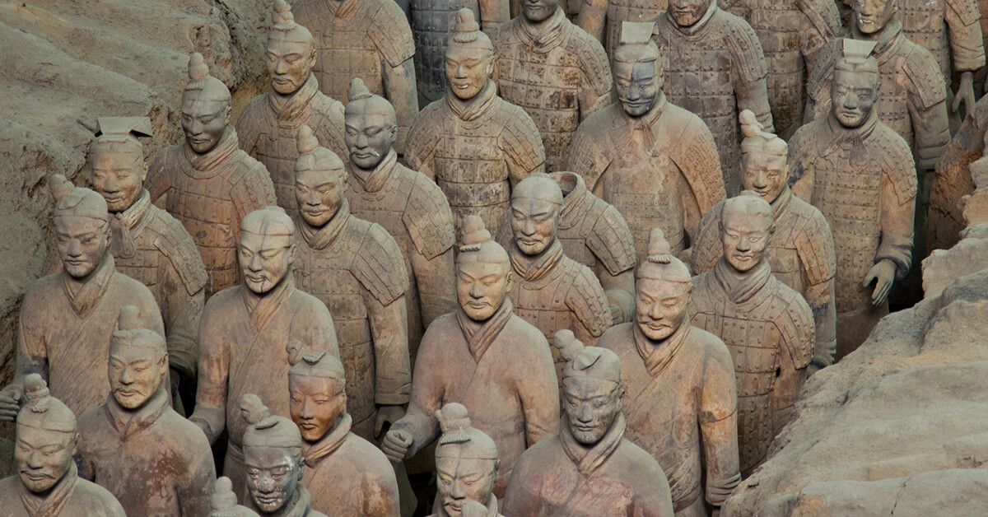
History
China has 3500 years of documented history starting Shang dynasty
Dynasties: Shang, Zhou, Qin, Han, Sui, Tang, Song, Yuan, Ming, Qing, etc.
Four Great Inventions: Papermaking, Printing, Gunpowder, and Compass
Government
Ruled by emperors in the past
Now ruled by one party

Slide 5
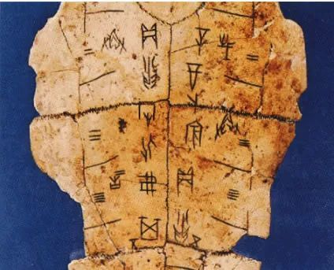
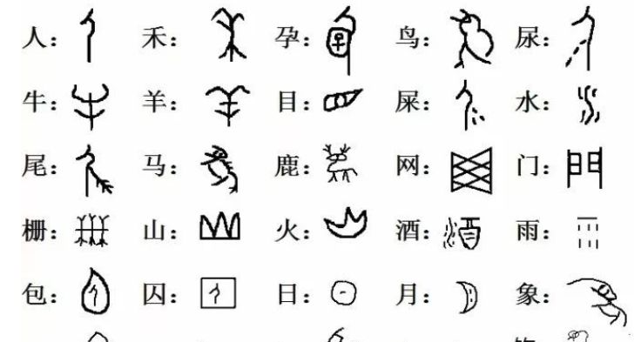
Language: From Oracle to Mandarin

Slide 6
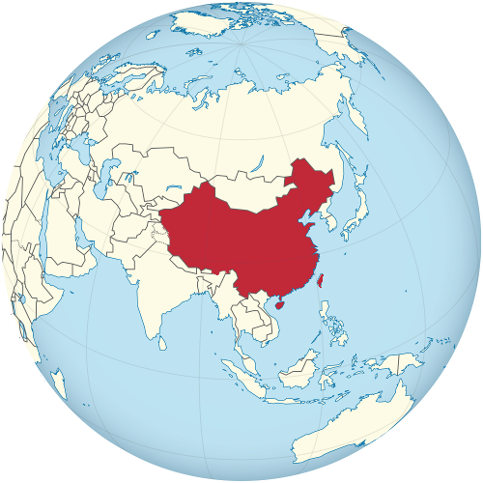
Geography
Located in Asia
Two major rivers: The Yellow River and The Yangtze River
Capital City: Beijing
3rd Largest Country behind Russia and Canada
Most population: 1.4 Billion
2nd largest economy by GDP behind USA

Slide 7
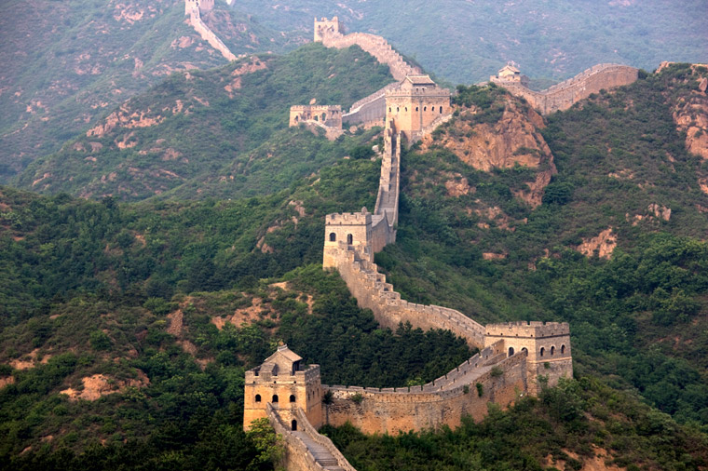
Landmark: The Great Wall

Slide 8
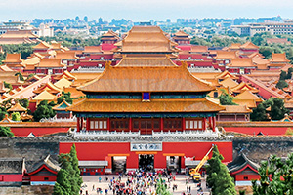
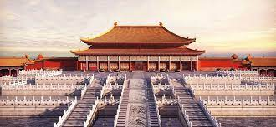
Landmark: The Forbidden City

Slide 9
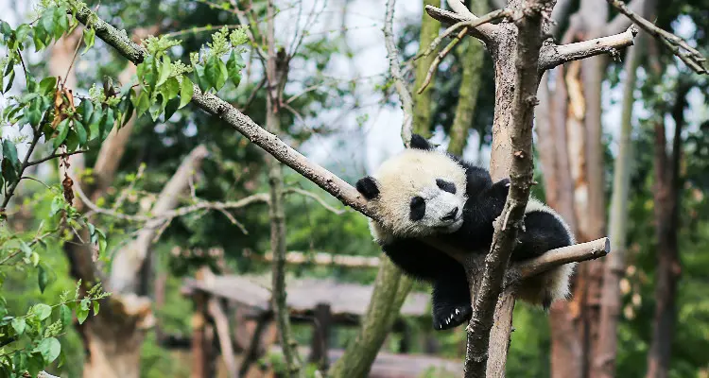
Landmark: Dujiangyan Panda Base

Slide 10
Landmark: The Terracotta Warriors Museum

Slide 11
02
HOLIDAYS AND CUSTOMS

Slide 12
Traditional Holidays
February 12, 2021
-
February 26, 2021
Lunar Calendar
A calendar based on the monthly cycle of the moon’s phases
Four traditional holidays/festivals
The Spring Festival
Starts with the Lunar New Year
Ends with The Lantern Festival
The Qingming Festival (The Tomb-sweeping Festival)
The Duanwu Festival (The Dragon Boat Festival)
The Mooncake Festival (The Mid-Autumn Festival)

Slide 13
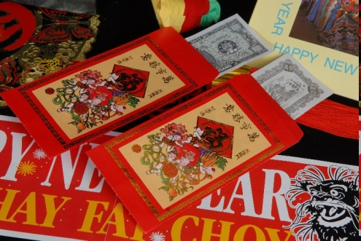
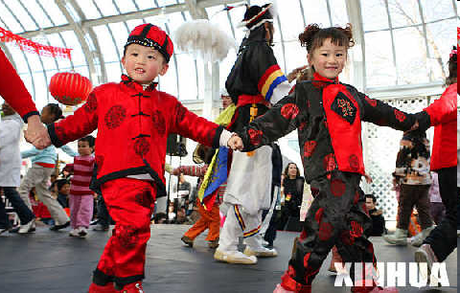
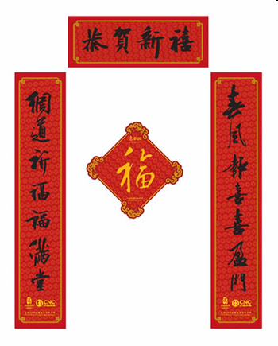
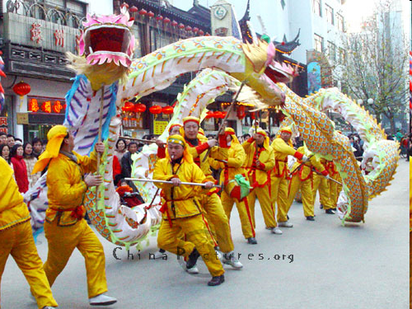
The Lunar New Year
The first day of the first lunar month
There are many activities during this festival:
New Clothes
Red packet
Lion and dragon dances
Fireworks
Door and window decorations
Great food

Slide 14
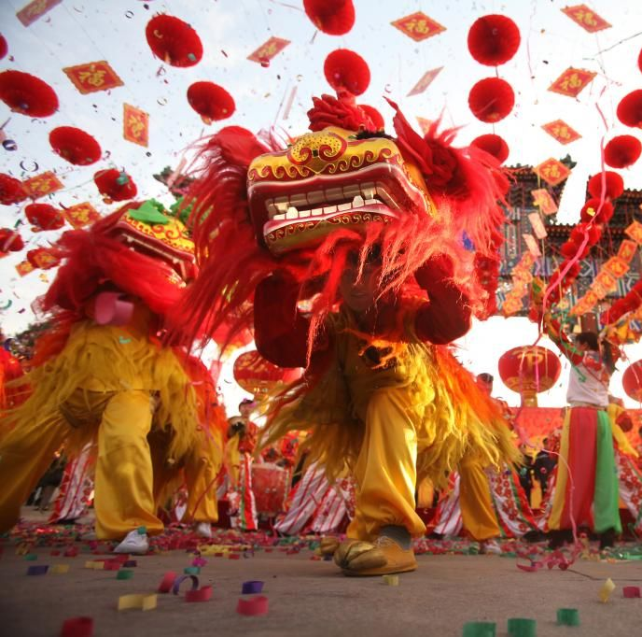
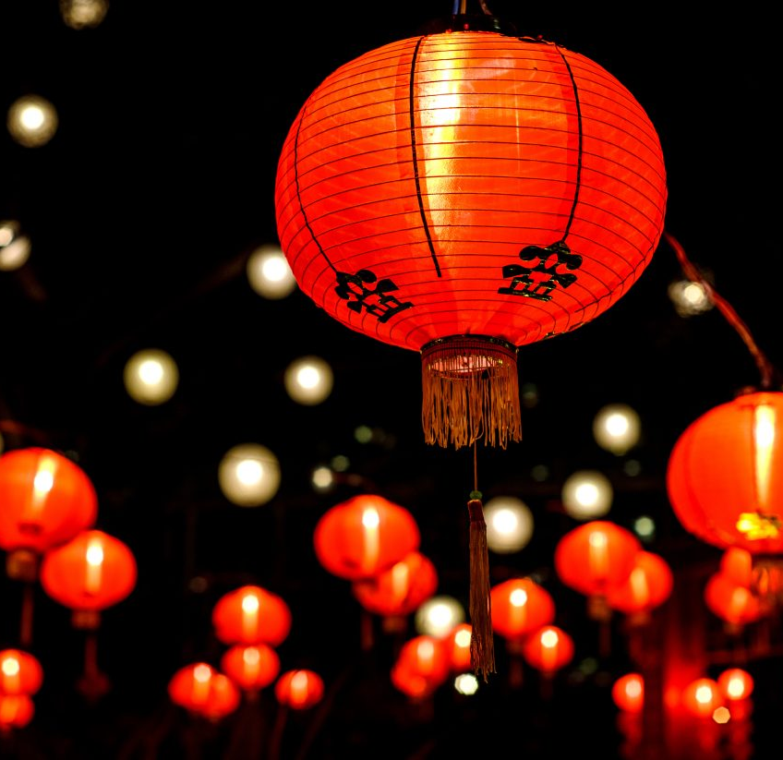
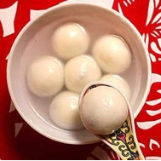
The Lantern Festival
The 15th day of the first lunar month
Marks the last day of the Lunar New Year Celebration
There are many activities during this festival:
Moon gazing
Lighting lanterns
Riddles
Lion dances
Eat Tangyuan (汤圆)

Slide 15
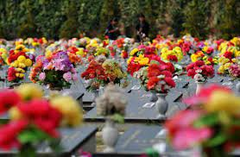
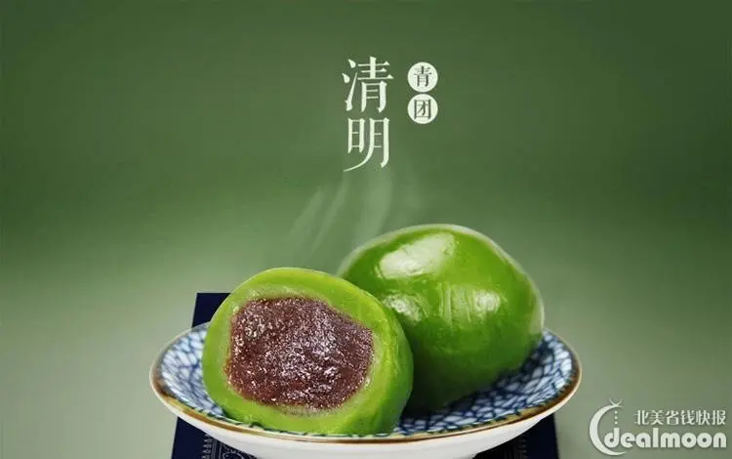
The Qingming Festival
Around the 4th or 5th day of April in Solar calendar
Show respect to ancestors and in memory of the loved ones
Tomb-sweeping Ritual:
Bow
Offer food, tea or wine
Burning incense, joss paper (representing money)
Eat Qingtuan (青团) in south China
Notes:
This holiday was based on one of the 24 solar terms in traditional Chinese calendar. The solar terms define different stages of Spring, Summer, Fall, and Winter in a year.

Slide 16
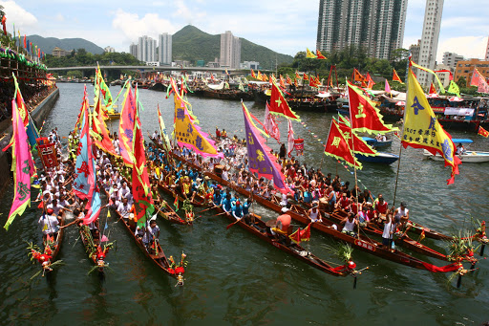
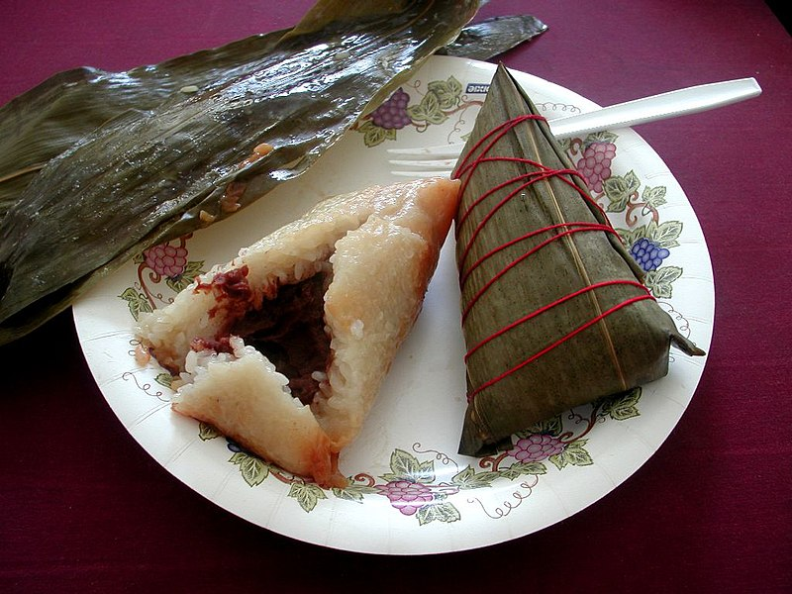
The Duanwu Festival
The 5th day of the fifth month in lunar calendar
In memory of a poet and minister named Qu Yuan
Dragon Boat Racing
Enjoy Zongzi (粽子)

Slide 17
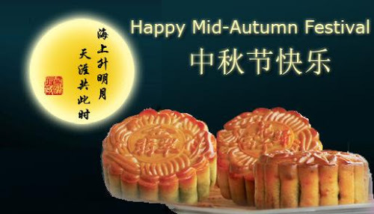
The Mooncake Festival
The 15th day of the eighth month in lunar calendar
Gathering of family
Thanksgiving: to give thanks for the harvest
Praying
Worship the moon and enjoy mooncake

Slide 18
03
Cultural Values

Slide 19
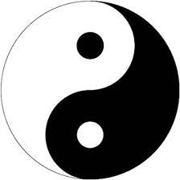
Three Main Philosophies of Ancient China

Slide 20
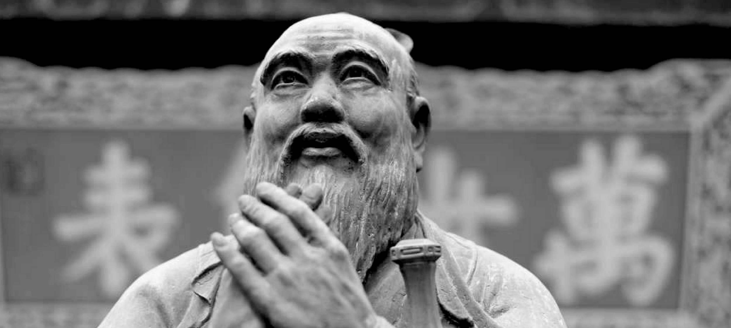
Cultural Values
Education
Hard working
Family
Parents often make great sacrifices to support their children
Respect and support the family’s senior member
Contributing to community and society
Balance between individualism and collectivism

Slide 21
04
CHINESE AMERICANS

Slide 22
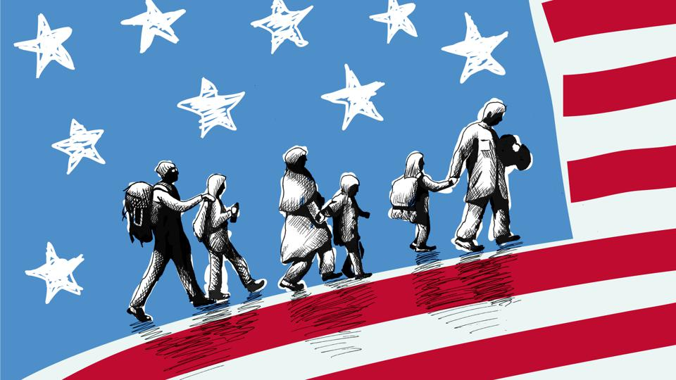
Why do we need to learn about China or any other Culture?
Develop a global, growth mindset
Proud of our identity with unique & diverse heritage
The American dream: Life, liberty, and the pursuit of happiness
Immigration is one of the main reasons that made America great
We are all descendants of immigrants from different cultural background and heritage
America is a cultural melting pot. We need to respect all races and backgrounds, and learn from each other
Learn Asian American history and their contributions to this country to connect the past with the present
Notes:
We need to learn not just China, but Chinese American history and their contribution to the American history

Slide 23
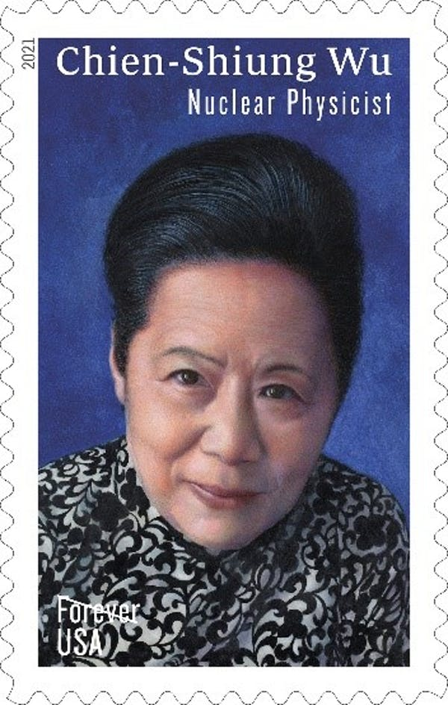
Scientist – Chien-Shiung Wu (吴健雄)
Manhattan Project main contributor
Nickname "First Lady of Physics"
Won many honors in her life
The inaugural Wolf Prize in Physics in 1978
The first woman with an honorary doctorate from Princeton University
First female President of the American Physical Society
First female to be honored with the National Medal of Science in Physics, which is the highest presidential honor for American scientists
In 2021, Wu became the eighth full-time physicist honored with a USPS postage stamp

Slide 24
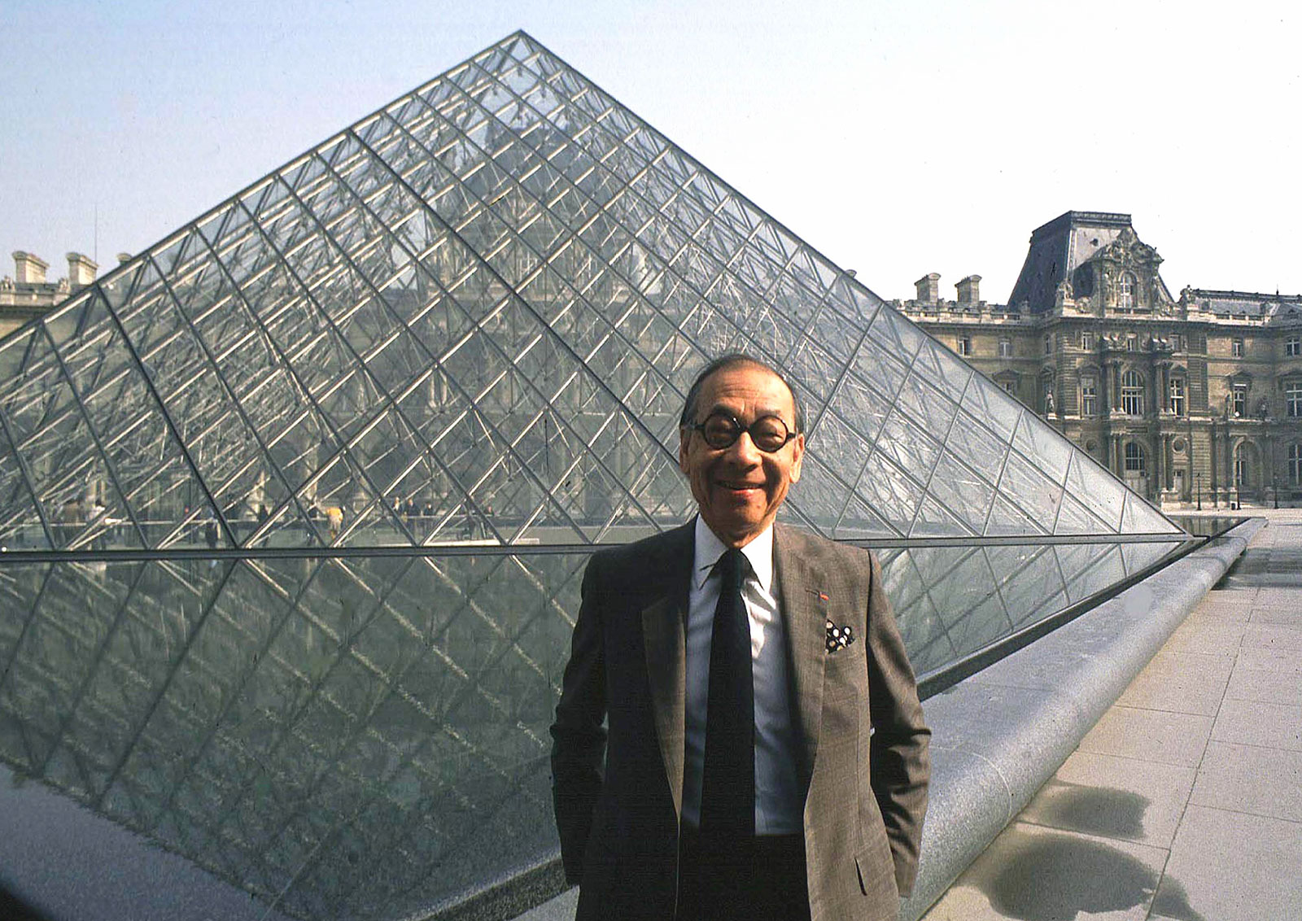
Architect – I.M. Pei (贝聿铭)
East Building of the National Gallery of Art in Washington D.C.
Louvre iconic glass pyramid in Paris, France
Museum of Islamic Art, Doha, Qatar
Miho Museum, Shiga, Japan
Bank of China Tower, Hong Kong
JFK Presidential Library and Museum, Boston
Luce Memorial Chapel, Taichung, Taiwan
Place Ville-Marie, Montreal, Canada

Slide 25
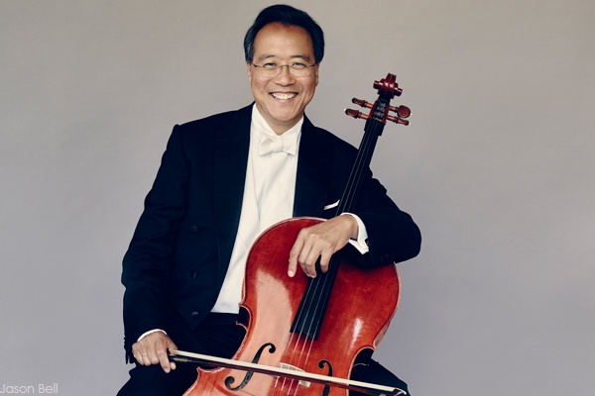
Musician – Yo-Yo Ma (马友友)
World renowned cellist
Recorded 90+ albums and received 18 Grammy Awards
A United Nations Messenger of Peace since 2006.
Awarded The Glenn Gould Prize in 1999, the National Medal of Arts in 2001, the Presidential Medal of Freedom in 2011, and the Polar Music Prize in 2012
Created the Silk Road Ensemble to bring the musicians together from countries along the Silk Road that linked the East and the West
At just seven years old, the young prodigy played for 34th and 35th US Presidents Dwight D. Eisenhower and John F. Kennedy

Slide 26
Athlete – Michelle Kwan (关颖珊)
Retired American figure skater.
Two-time Olympic medalist (silver in 1998, bronze in 2002)
Five-time World champion (1996, 1998, 2000, 2001, 2003)
Nine-time U.S. champion (1996, 1998–2005)
Tied with Maribel Vinson for the all-time National Championship record

Slide 27
谢谢 Thank You
Credits: This presentation is based on a PPT by Eleanor Xiao from PiPa Magazine. www.pipamag.org
The template was created by Slidesgo, including icons from Flaticon, and infographics & images from Freepik.

